Slide 1
What can we do to continue being faithful to the educational essence of the Sacred Heart? How can we live our own identity in the everyday life of our schools?
Notes:
In this session the aim is for you to share your experiences about how you answer these questions in your own schools and networks. By now you will have realised, if you are new to the European level of SH meetings, that while there is so much that unites us, we work in very different environments determined by our histories, educational systems, dioceses, methods of funding, admissions systems, the way the Society has evolved in our countries and provinces. Whilst we cannot always copy exactly what another school or network does, there is a lot we can learn from each other to shed light on our own situations or implement in a different way. There is huge richness amongst us and realism!

Slide 2
What can we do to continue being faithful to the educational essence of the Sacred Heart?
What is the educational essence of the Sacred Heart?
What is our mission?
Notes:
So the first task is to remind ourselves of our mission as Sacred Heart Educators. I will leave the English speakers to read the slide while the French/Spanish can hear it!

Slide 3
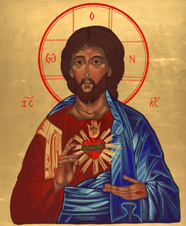
The Charism of the Society:
By our charism, we are consecrated
to GLORIFYING THE HEART OF JESUS:
we answer His call
to discover and reveal His love
letting ourselves be transformed by His Spirit
so as to live united and conformed to Him,
and through our love and service
to radiate the very love of His Heart. (4)
Notes:
You all have copies of this and a couple more of the constitutions to do with education in the 2 languages here.
Following Vatican II the Society undertook lengthy and full revision of their constitutions. If you look briefly at the other 2 on our sheets you will see the ideas which influenced those drawing up the documents we use in schools, like the Goals…Caracter proprio etc The constitutions are a beautiful document. Number 4 here is one of the key clauses. Written for the primary interpreters of the mission of the Sacred Heart using religious terminology, I would dare to say that I can see this alive in the schools I visit where there are no RSCJ and sometimes there haven’t been for a while

Slide 4
Schools whose name/foundation call their members to be the compassionate Heart of Jesus in the world today
Notes:
If we are true to the names/foundation of our schools this is what we are about…..

Slide 5
“Values taken for granted or left unarticulated become inoperative.”
(from the website of the United States Canada Network of Sacred Heart schools – www.sofie.org. The Preamble of the original edition of the Goals and Criteria)
Notes:
However…. A Headteacher new to Sacred Heart Education in our network said to me a few years ago, “But Hilary the teachers here love being a Sacred Heart School, but they can’t explain it to me, they can’t say how what is different.” It is essential that not only we can name it and live it, but also the rest of our school communities need to explain it and live it too... In the way that they can.

Slide 6
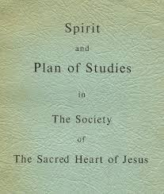
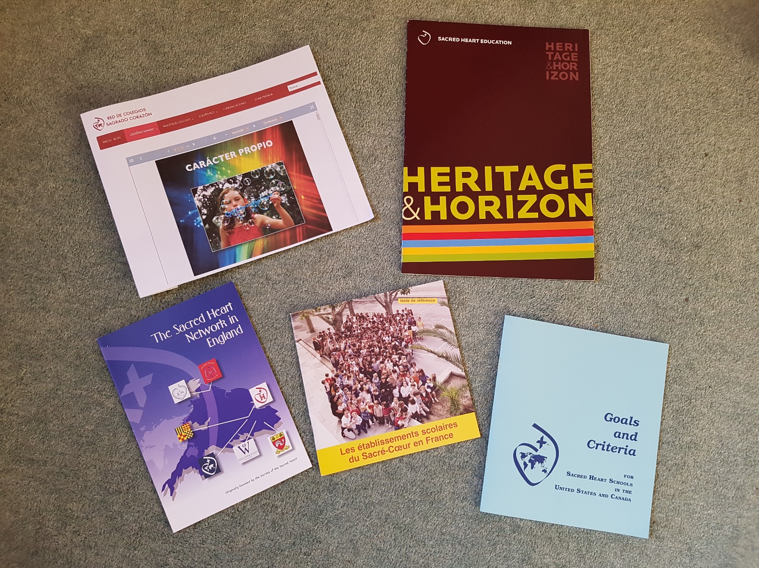
Notes:
Over the years it was the Plan of Studies ( which Sophie said they had to keep revising) that named what was Sacred Heart Education. In the 1950s a revised document acknowledged the differences across the SH world and it became the Spirit and Plan of Studies. Now of course we have our own documents that differ in style across the networks, but the essence of our charism/ our identity rings.. if not “radiates” through them all. As with any document it needs to be put into practice, to be interpreted, understood, to be accepted and lived…

Slide 7
Group activity What are the characteristics and values of our educational spirit? Are there some which are non negotiable for a Sacred Heart School?
Notes:
Our first task for you. This will be quite quick. It will be better to be in language groups. We will give you….. minutes For feedback: 3 suggestions from each group ( not repeating what a previous group has said) translated as needed.

Slide 8
Some examples: (slide not used in session)
The Heart of Jesus: our charism
Quality of relationships
Openness
Value of the whole person
Concern for students, staff
Rigour in education
Service
Spiritual life
Our story, our saints, our feasts
Education for justice, peace and the integrity of creation
Sense of community that goes beyond the school…
Education for leadership
Education for compassion and hope
Development of the person
Notes:
Depending on time and what the feedback is like we may or may not use this slide. THIS SLIDE WAS NOT USED IN THE SESSION. IT WAS AN EXTRA__just in case!

Slide 9
Group Activity What are the obstacles we meet?
Notes:
I don’t think you will have any problem listing these! Take…….. Minutes At the end of that time. I will say we will move straight on to the next question.

Slide 10
Group Activity What are the steps we have to take to embed our charism and values and to help them flourish and grow?
Notes:
This is your opportunity to share what you think has to be in place in our schools for them to remain faithful to their essence as Sacred Heart schools, working as partners in mission with the Society ( which may be at some distance). Saying how you actually do these will be helpful. Longest time on this leaving time for feedback. Feedback could be giving examples of what each other do.

Slide 11
Some examples: (slide not used in session)
Professional development (as well as induction) in the ethos at all levels; governors, leadership, teachers, other staff, pupils. Programme to educate families
Investment in the spiritual life of the school
Creativity in engaging staff in understanding and promoting the spiritual life of the school
A challenging and appropriate curriculum with teaching and learning styles that address the needs of all
Connection where possible with RSCJ or their initiatives/full use of technology
Creating an atmosphere for positive relationships to flourish
Appoint/ask staff to have responsibility for aspects of the SH life of the school
Connection where possible with RSCJ or their initiatives/use of technology
Keeping up to date/involved with developments in the Society: major anniversaries,
Celebration of key feasts
Displays/art work in schools to reflect the charism.. Images, words
Formal evaluation of SH life of the school in the School Self Evaluation systems
Engagement with other Sacred Heart schools
The Goals/Projet Educatif/Caracter proprio present and lived
Methods to keep staff on board
Initiatives to encourage leadership
Service opportunities
Notes:
These are but some examples THIS SLIDE WAS NOT USED IN THE SESSION. IT WAS AN EXTRA__just in case! In your discussions you will have shared how you do them.

Slide 12
Taking inspiration and strength from those who have gone before us….
“The only way to govern is to love. Then the whole of life and responsibility blossoms and bears fruit.”
“El único camino para dirigir es amar. Así, toda nuestra responsabilidad y nuestra vida florece y da fruto.”
“Le seul moyen de gouverner est d’aimer. Alors toute
la vie et les responsabilités s’épanouissent et
portent des fruits.”
Janet Erskine Stuart RSCJ, Superior General 1911-1914
Notes:
In our network, as in others, we have calendars and books which have quotations that give us those lifts we need and sometimes make us smile, for example this is one from Philippine Duchesne, “ If only I could be hidden in a corner; so as not to be tempted to worry about things that are not really my business!”

Slide 13
To be a joy-bearer and a joy-giver says everything: it means that one is faithfully living for God
Etre quelqu’un qui porte la joie et qui donne la joie dit tout : cela signifie que la personne vit pour Dieu avec confiance
Ser portador de alegría y dador de alegría lo dice todo: significa que uno/a vive en fidelidad a Dios
Notes:
And finally, more Janet Stuart…

