Slide 1
Africa Outreach
To Uganda Kenya Province
Visit to Kenya
Sacred Heart High School, Newcastle
July 15th-August 1st 2016
With thanks to John Blissett, Willetts Safaris
http://www.willetts-safaris.co.uk/

Slide 2
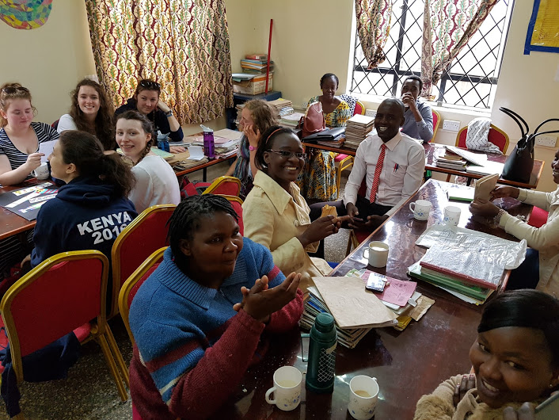
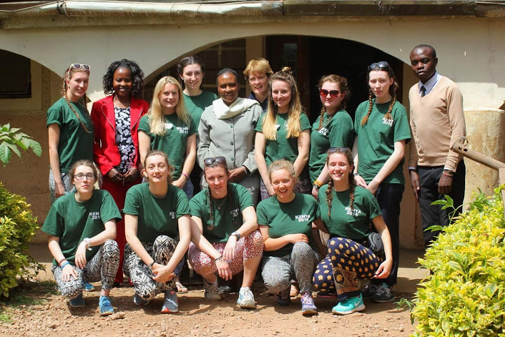
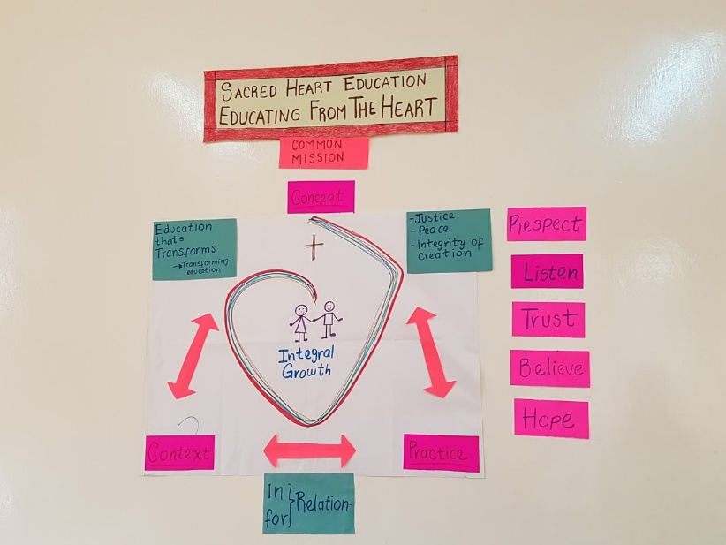
The group with Sr Lucy Toror RSCJ and some of the staff

Slide 3
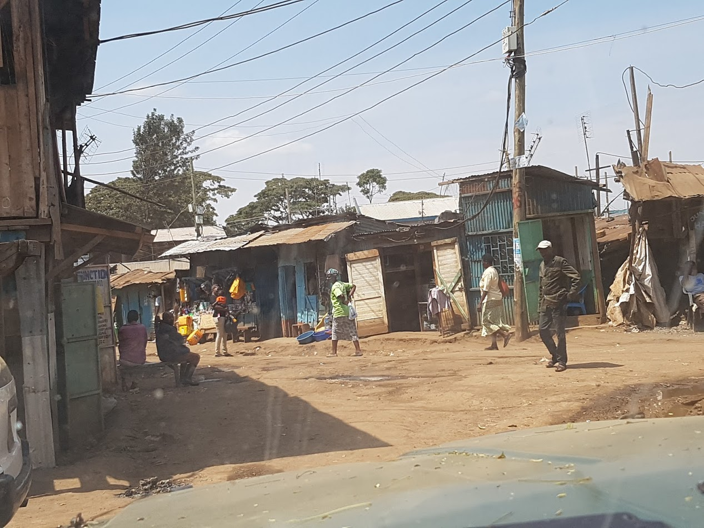
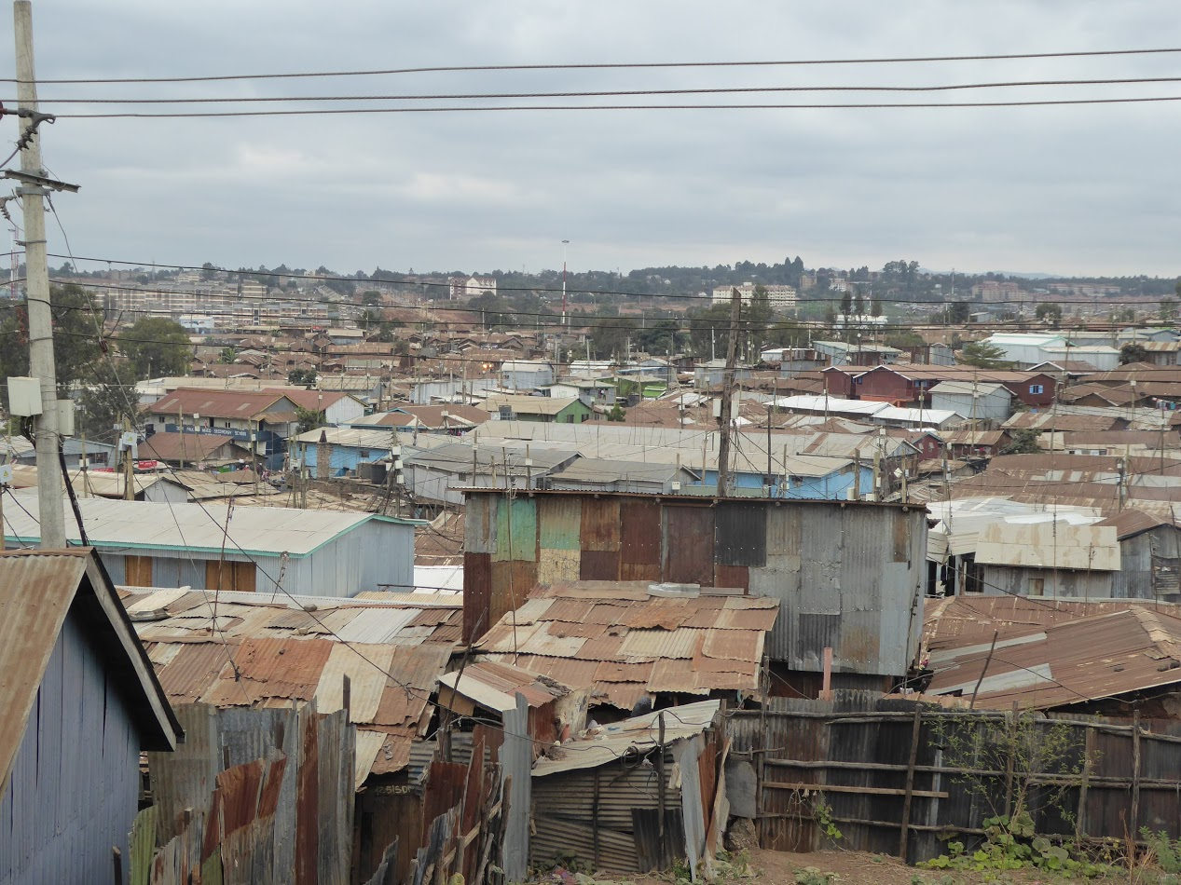
Nothing could have prepared us for the drive through Kibera to the primary school; it definitely has to be one of the most shocking moments of the whole trip. It was upsetting seeing the conditions these people live in, no photo on the internet or documentary could compare to actually seeing it in person. It made us feel angry that people have to live this way. It is extremely unfair.

Slide 4
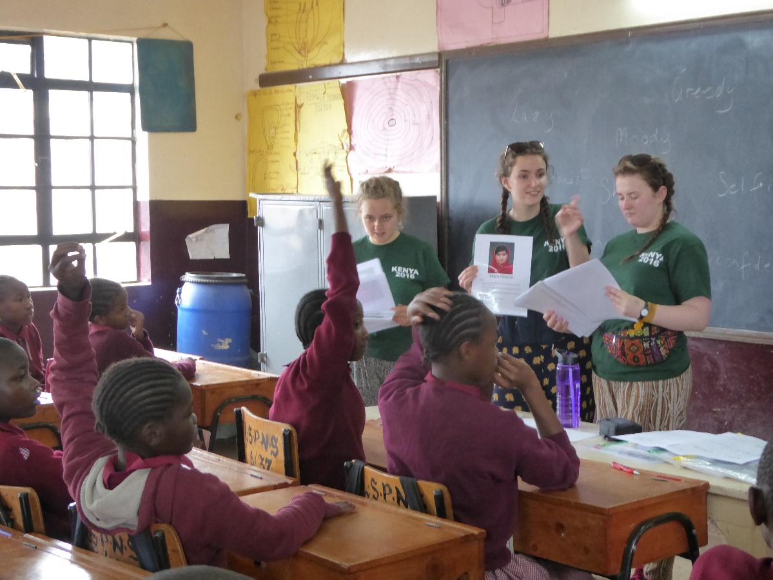
Being in school
The sense of school community was very strong which was nice to see. Moreover, the teachers were very driven to help the students.

Slide 5
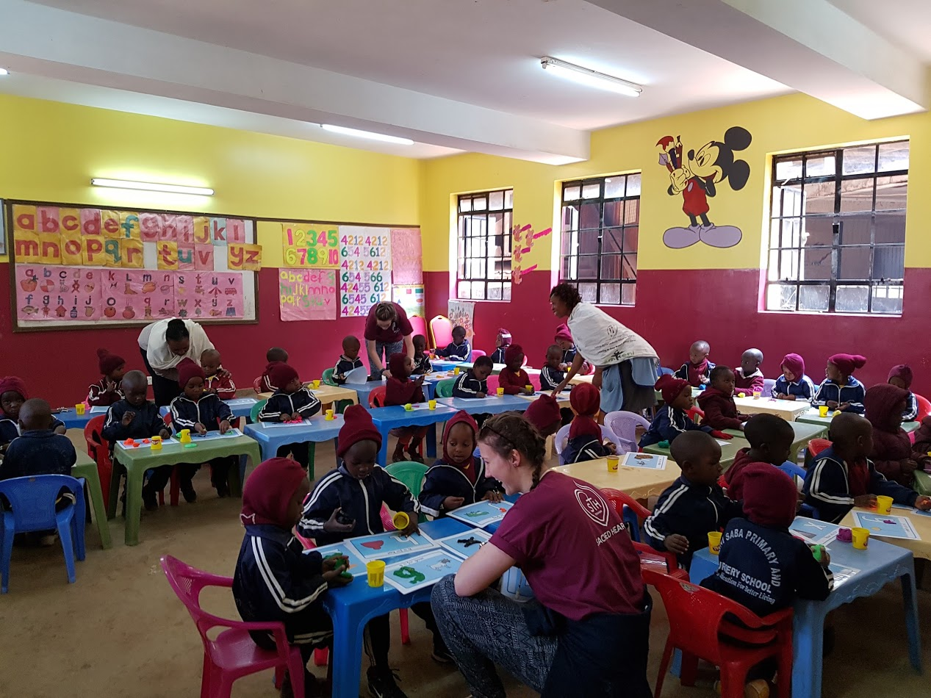
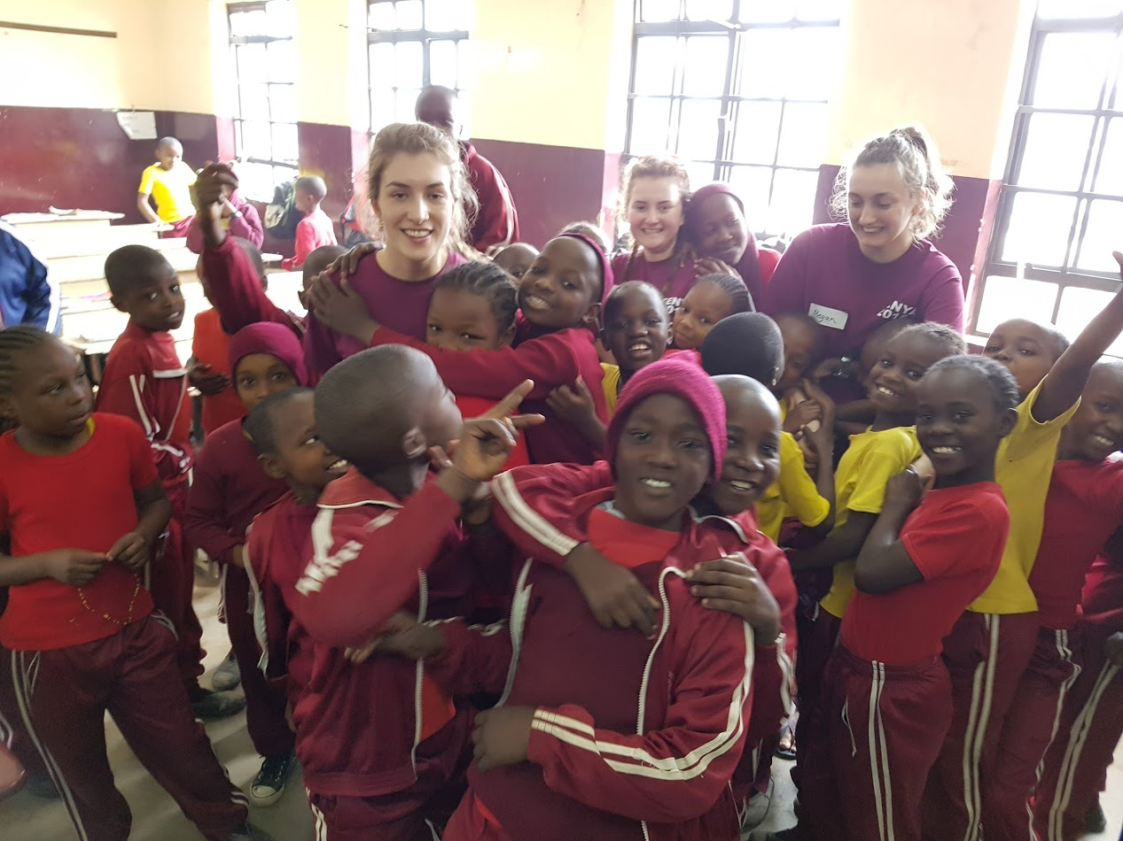
Seeing the children who were always so joyful and happy despite the fact that they live in such a poverty stricken area made me think a lot about the kids in the UK and how we don’t realise just how lucky we are to have access to education so easily.

Slide 6
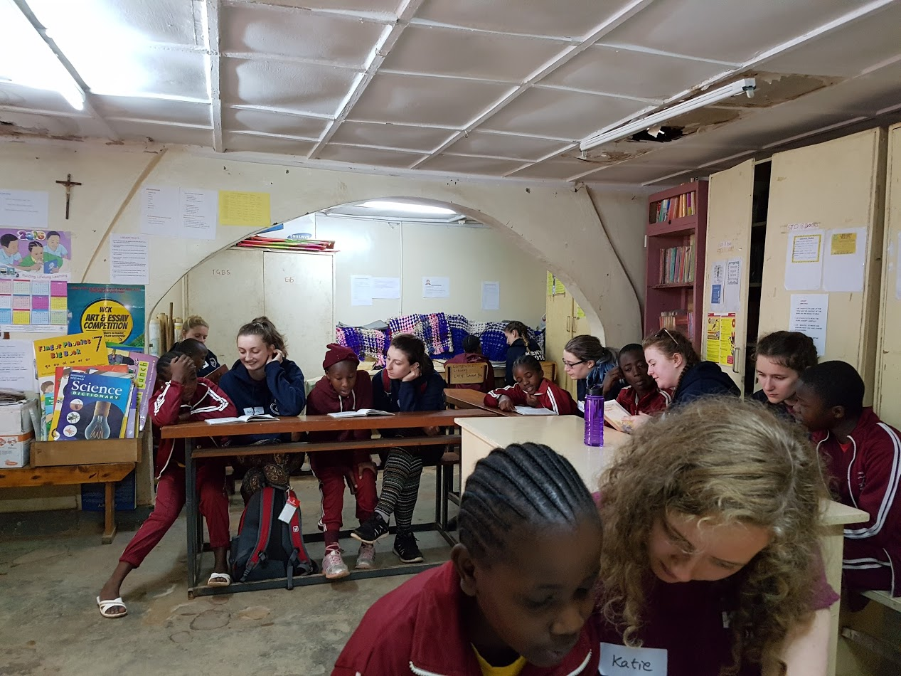
In Kibera most of the children have to be lucky enough to get a sponsor just to complete their education.

Slide 7
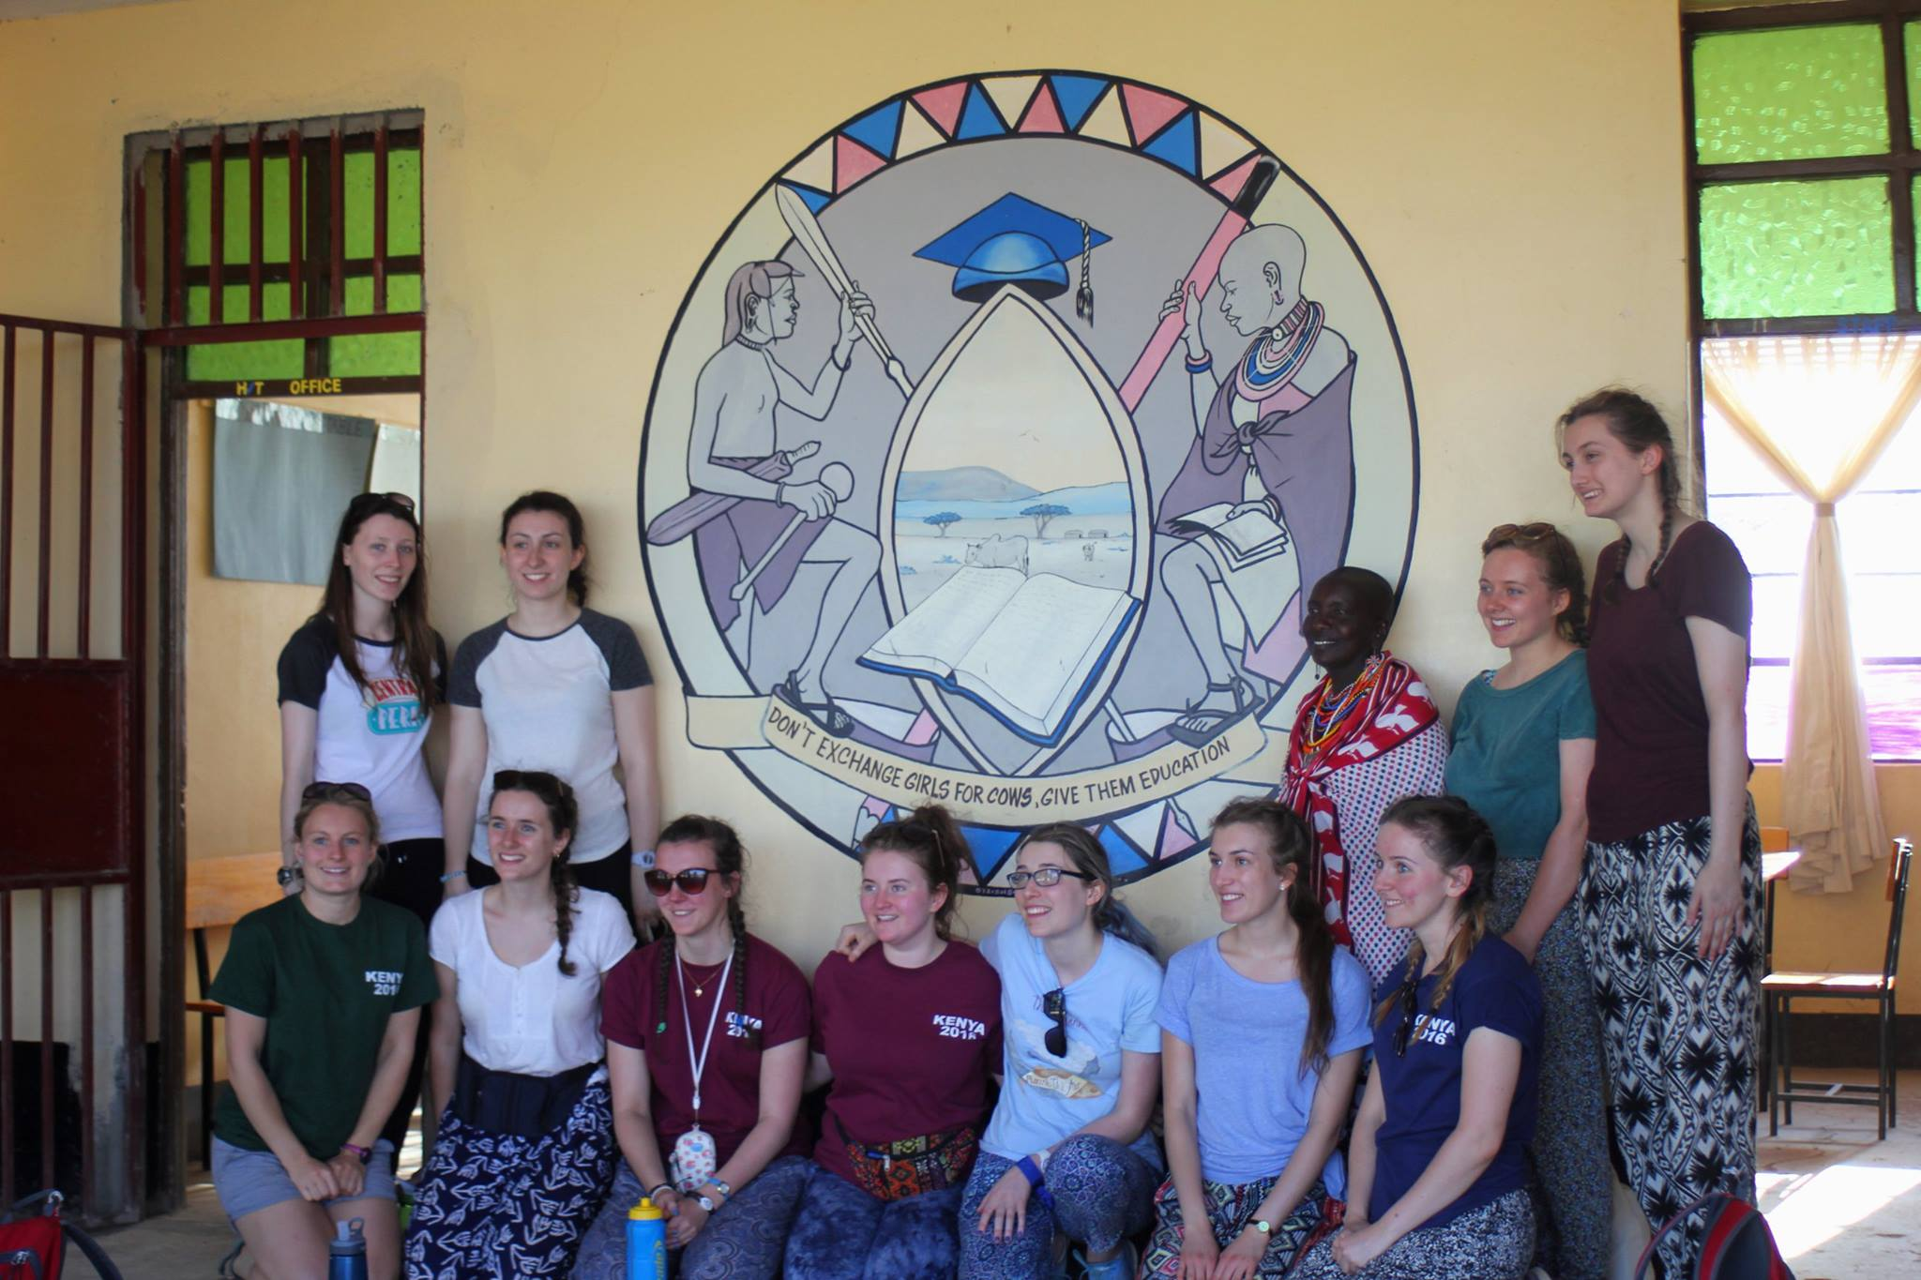
After Nairobi we travelled to Masai land. One of the first stops was to a school for victims of FGM; then we camped near a Masai village whose people welcomed us warmly and were lucky to have a couple of days safari in the Masai Mara. Many thanks to Willetts Safaris for introducing us to these new friends and their home land.
It was definitely a real eye-opener to meet Helen (the head teacher) and hear about her life. It made us realise just how lucky we are to be 18 years old and to not be a victim of FGM, or be married with children and without an education. However, it was amazing to see Helen brave and willing to stand up for young girls who cannot stand up for themselves. The students were stunned to hear how fortunate we are to not be victims of FGM.

Slide 8
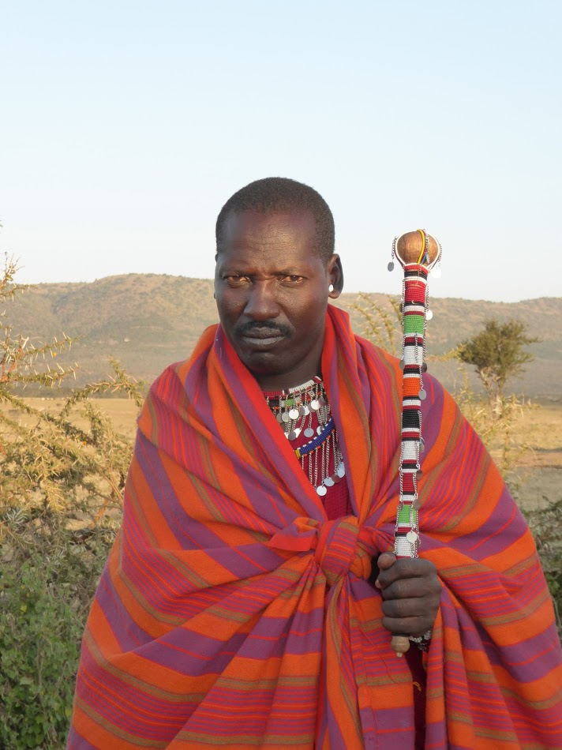
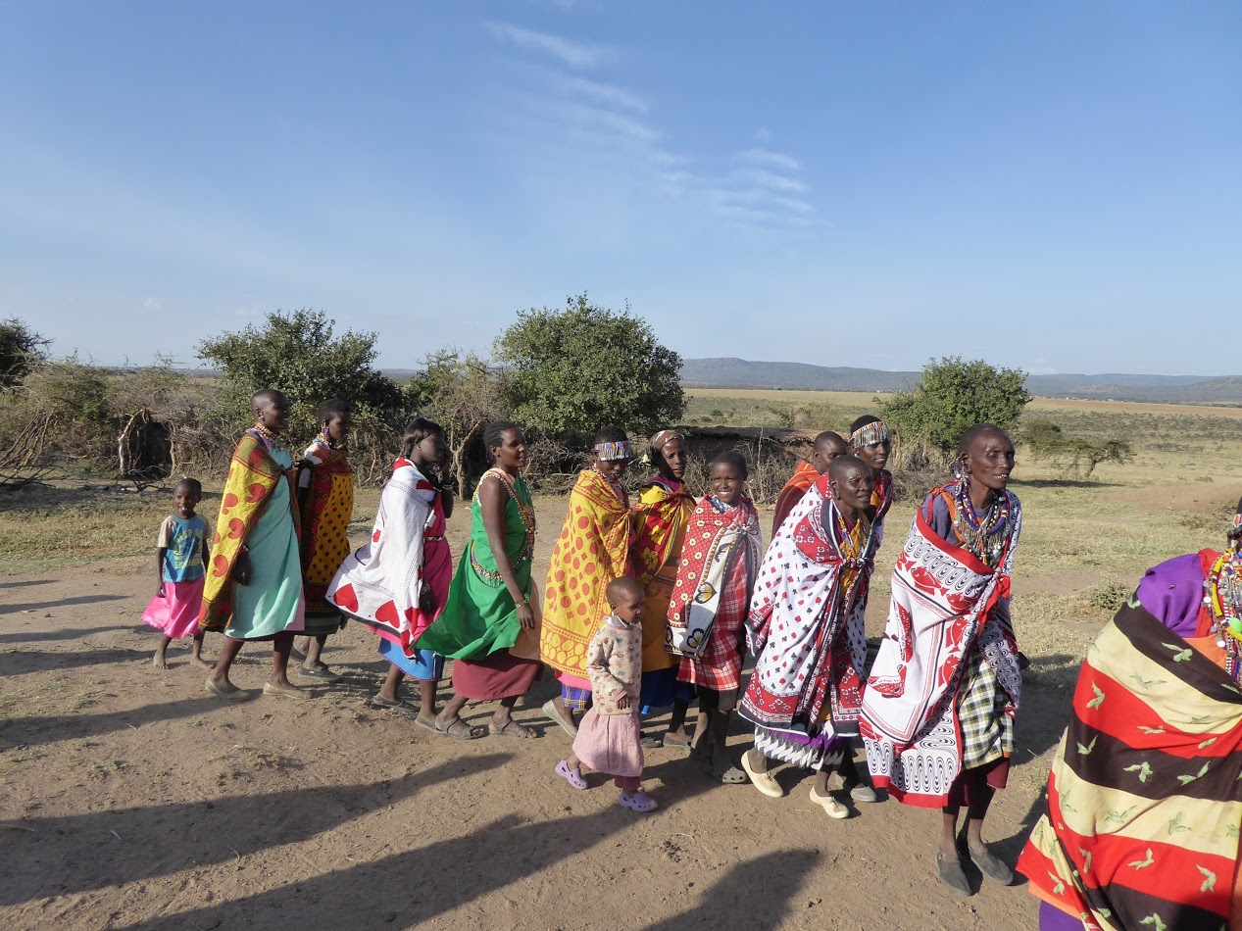
It was so interesting learning about the Maasai culture, in particular how the warriors are secluded from society during their teenager years and live in the bush during this time. The knowledge they gathered of the bush was clearly demonstrated when we walked to Lebentara as they pointed out different animal bones and footprints to us.

Slide 9
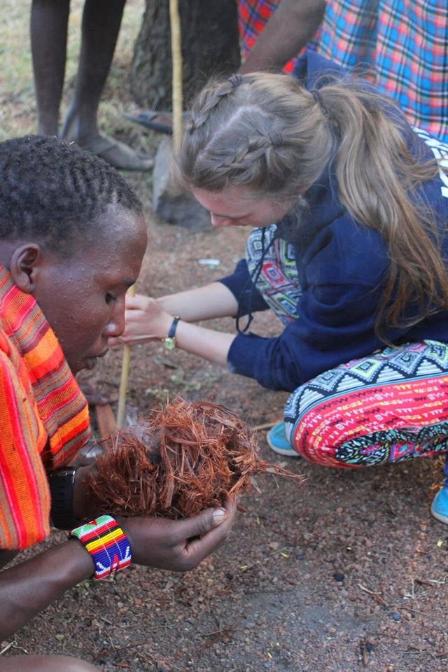
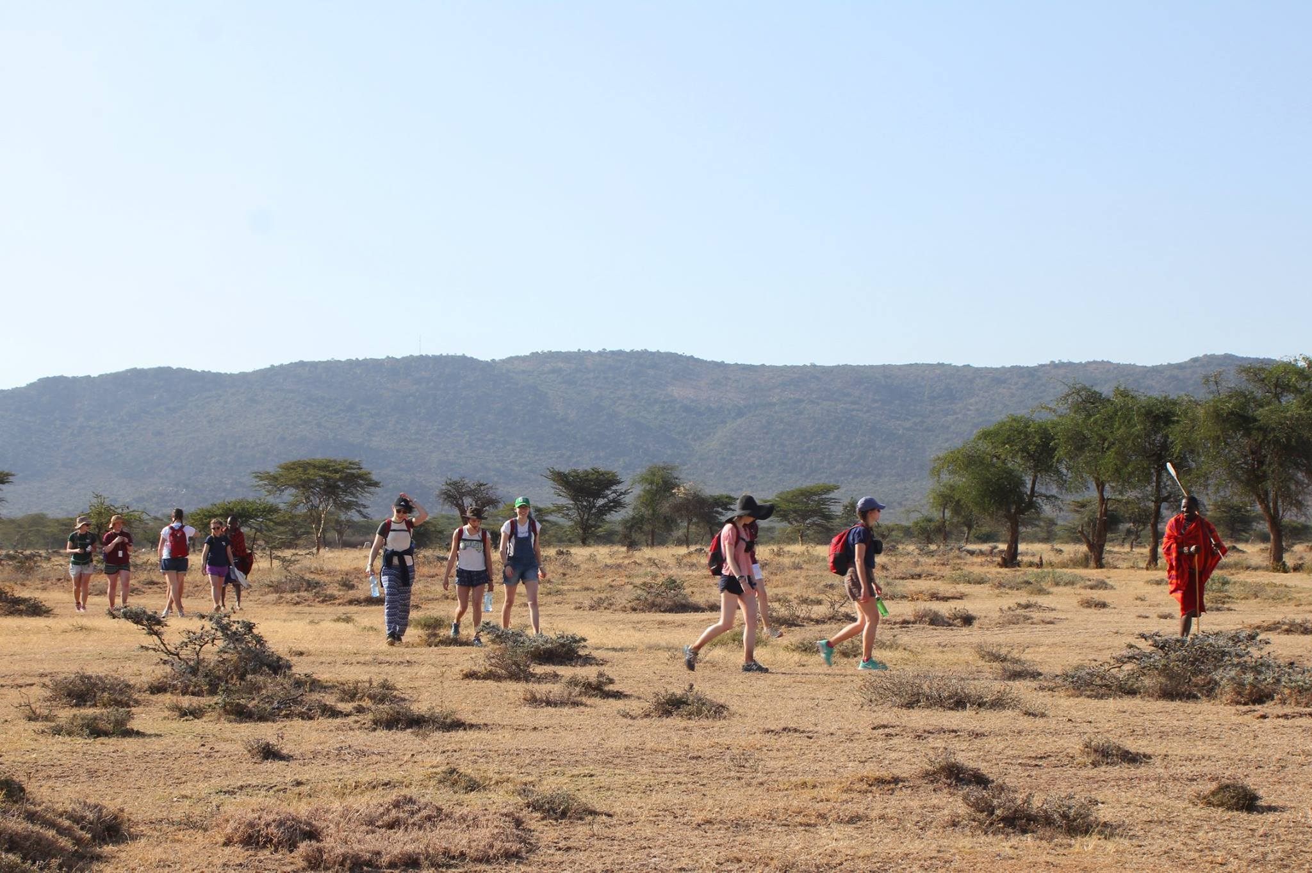

Slide 10
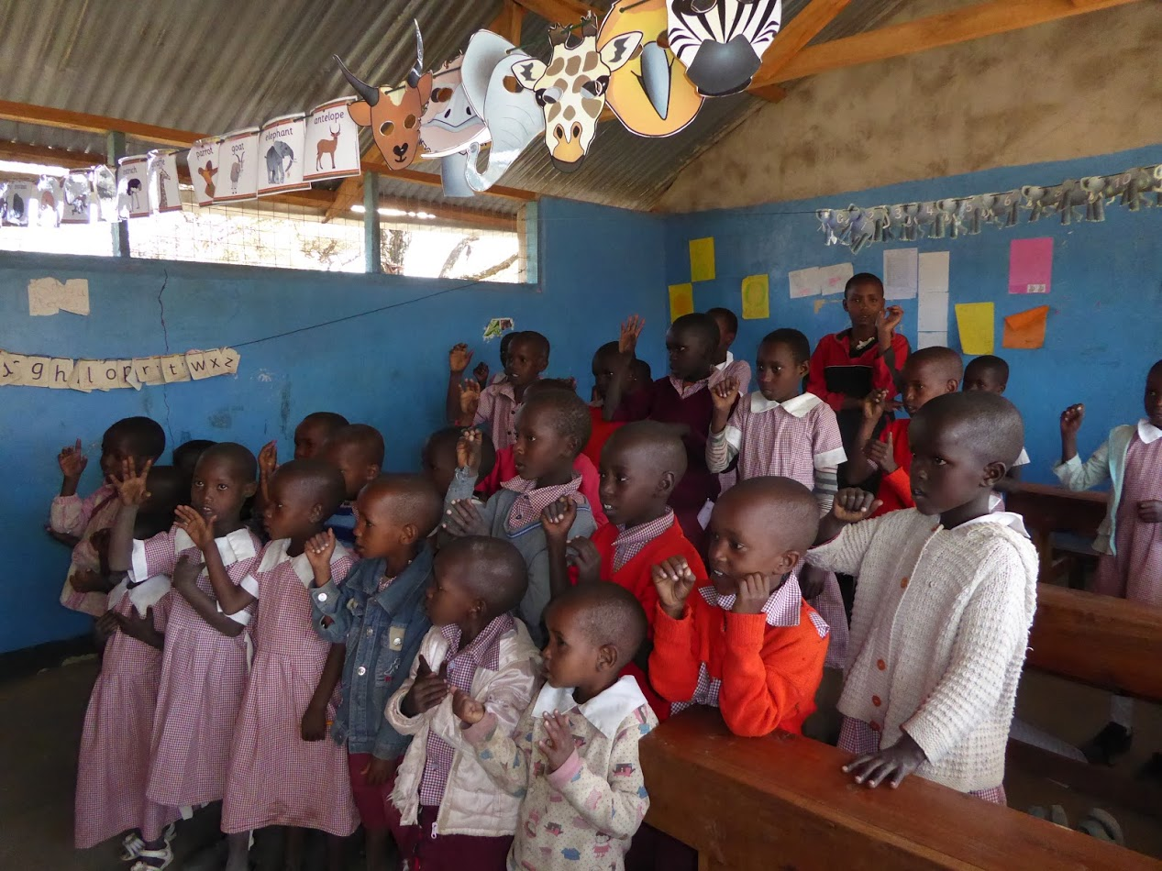

Slide 11
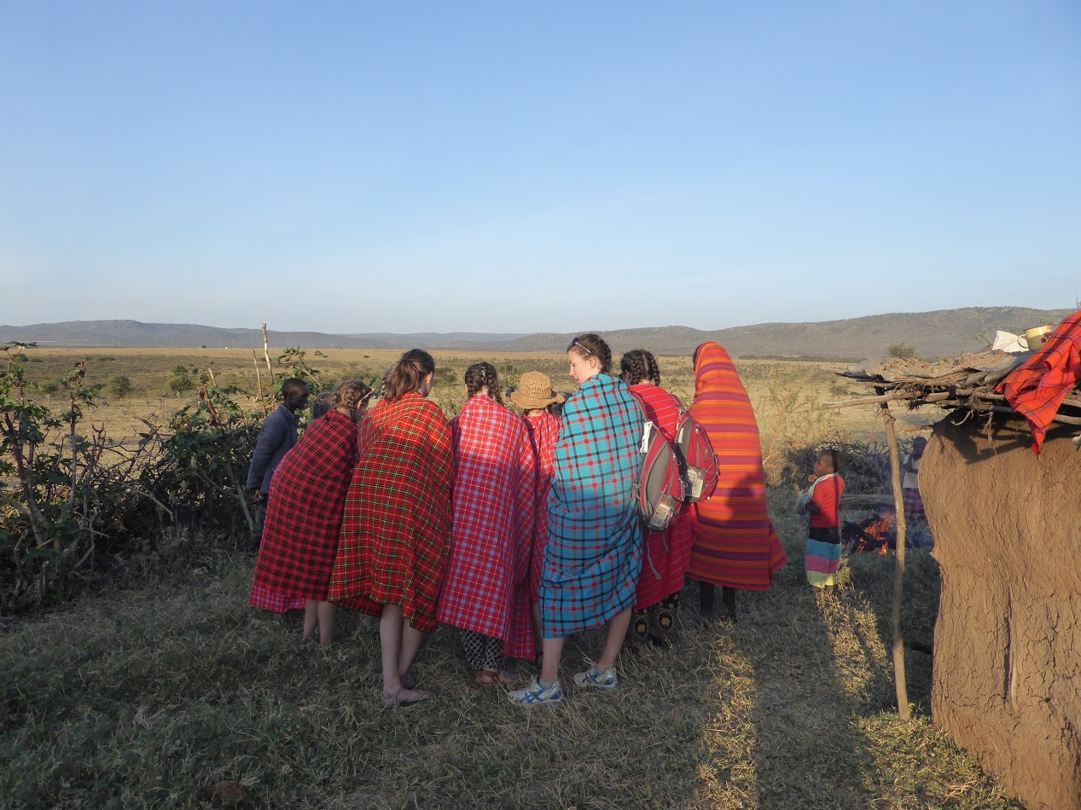
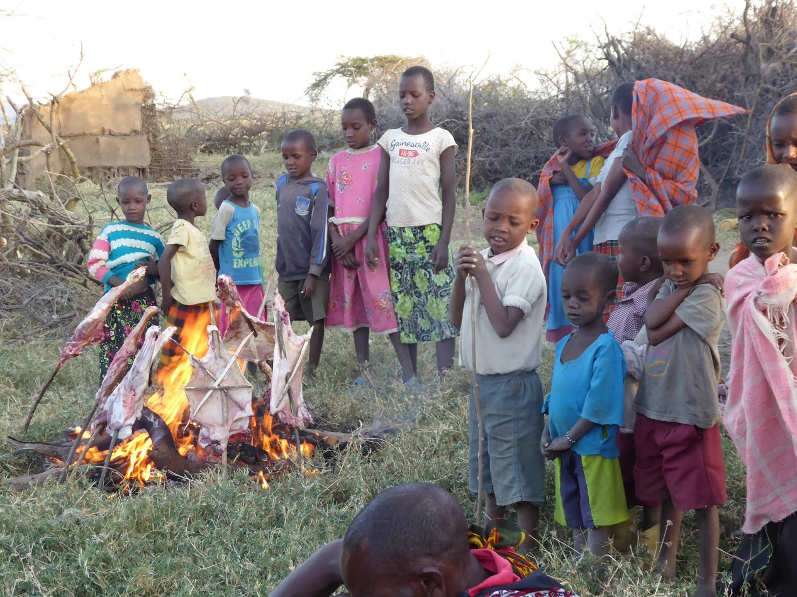

Slide 12
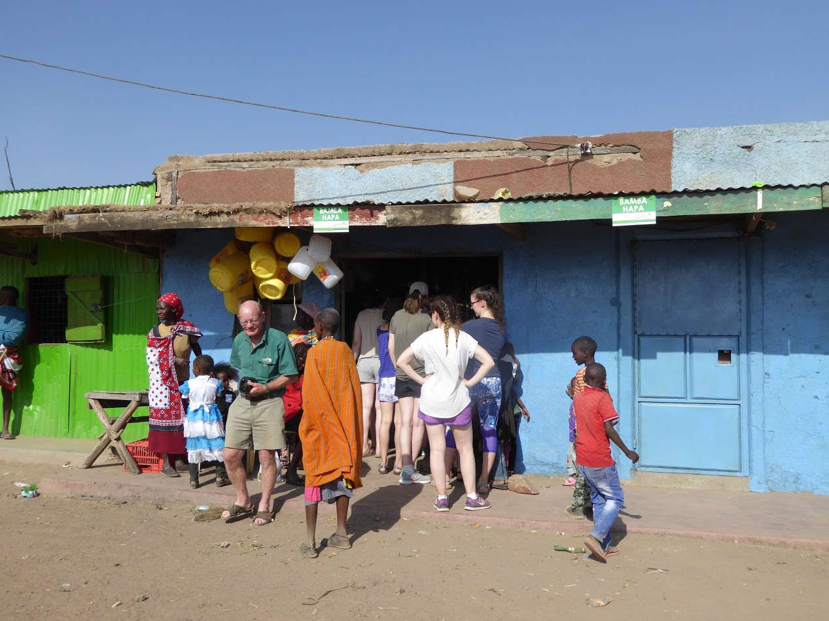
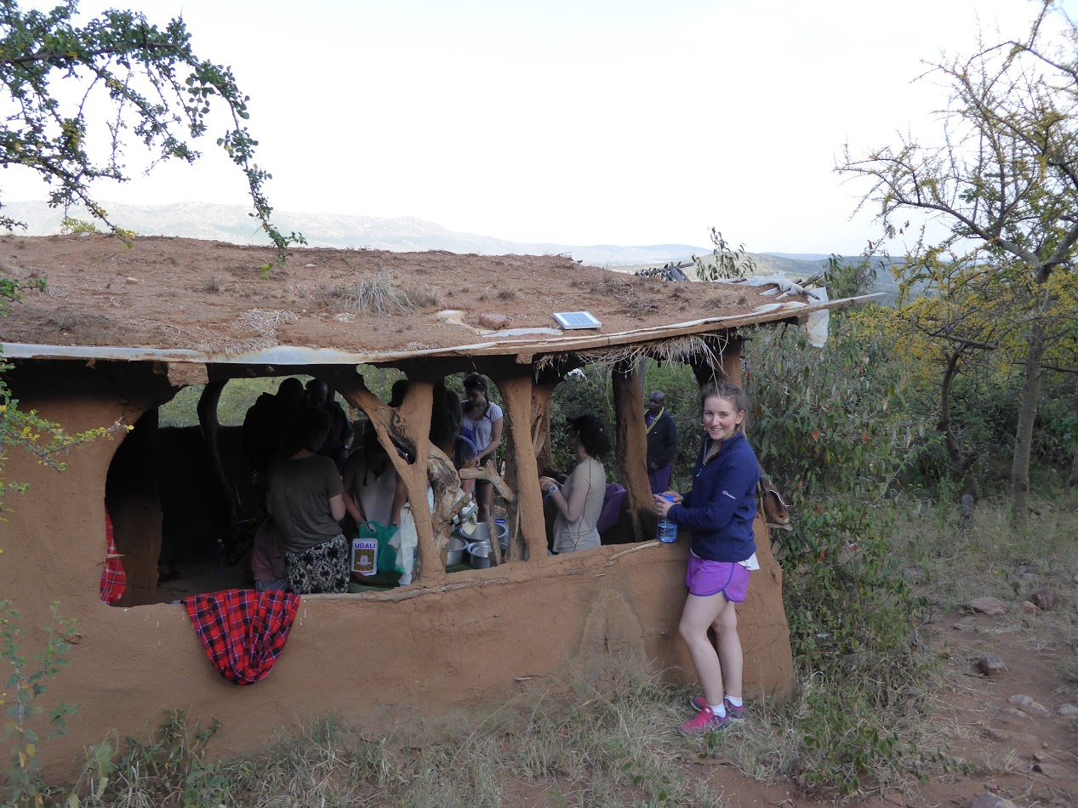
Working with the Maasai to help build the road made me realise just how difficult it is for labour workers in Kenya as the work was extremely tiring especially because of the blazing hot sun.
When we tried to buy and cook a meal with the wages of a typical labourer in Kibera, we began to truly appreciate what a challenging task it is. This was without taking into account money for we didn’t housing bills, water, school fees etc. This reinforced how lucky our lives are in the UK.

Slide 13
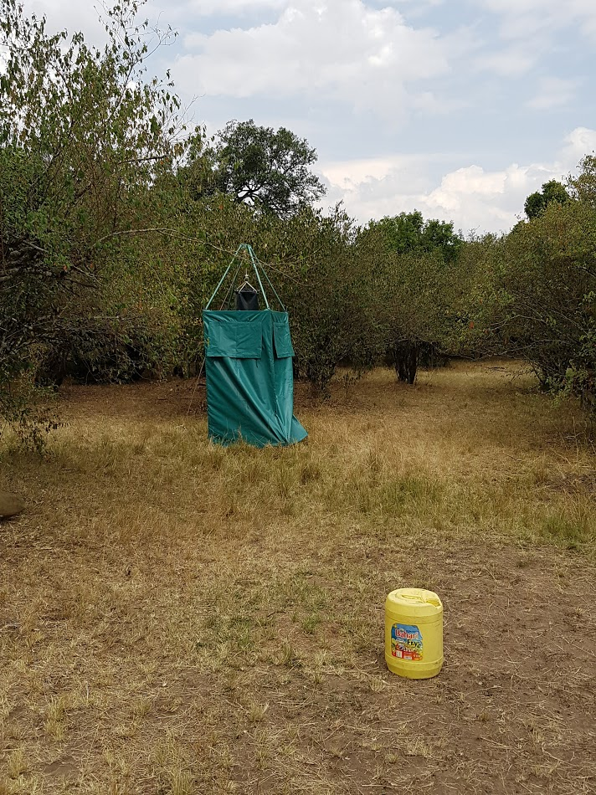
We are constantly told to be grateful for everything we have, but I have never truly appreciated how fortunate I am until this trip. It proves that material possessions are not important. The trip was emotionally draining, yet equally as rewarding. We all felt pushed in different ways such as learning to appreciate what we have, trying new foods and being away from our families and away from the world news for so long – it felt strange yet sometimes quite nice to be cut off from the outer world.

Slide 14
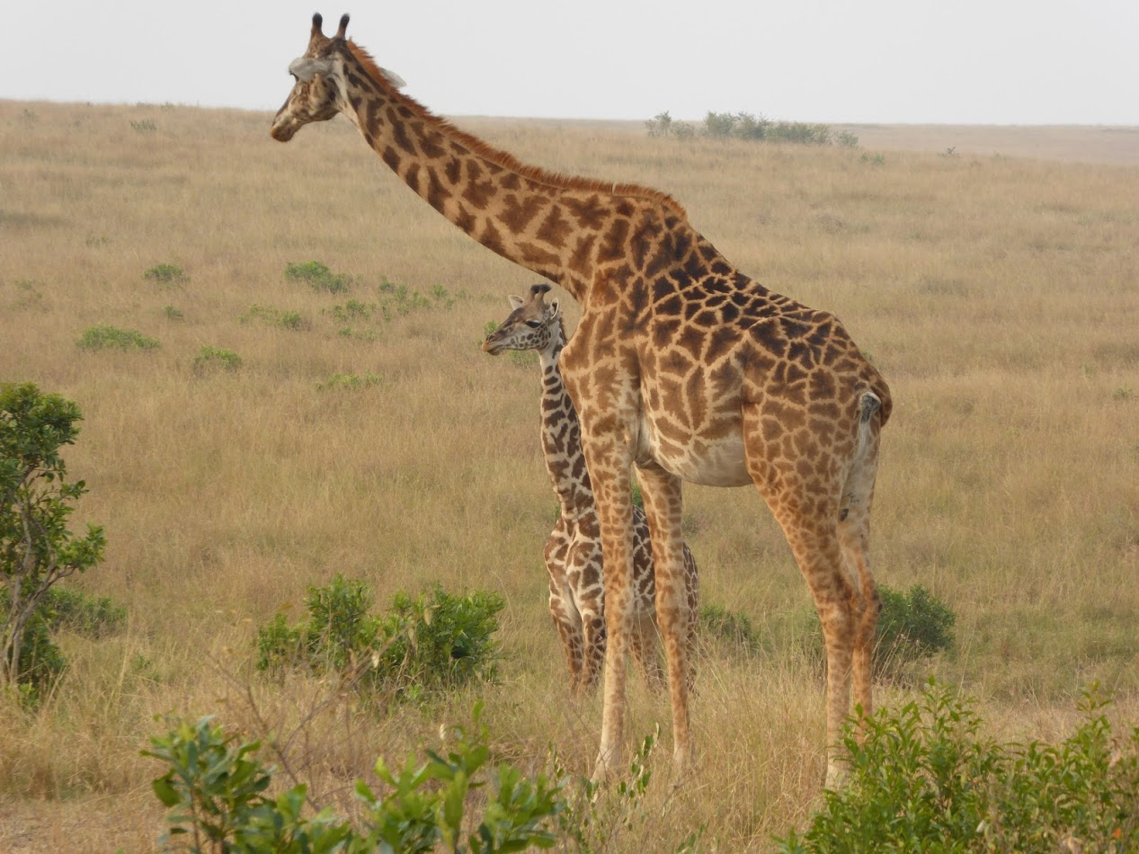

Slide 15
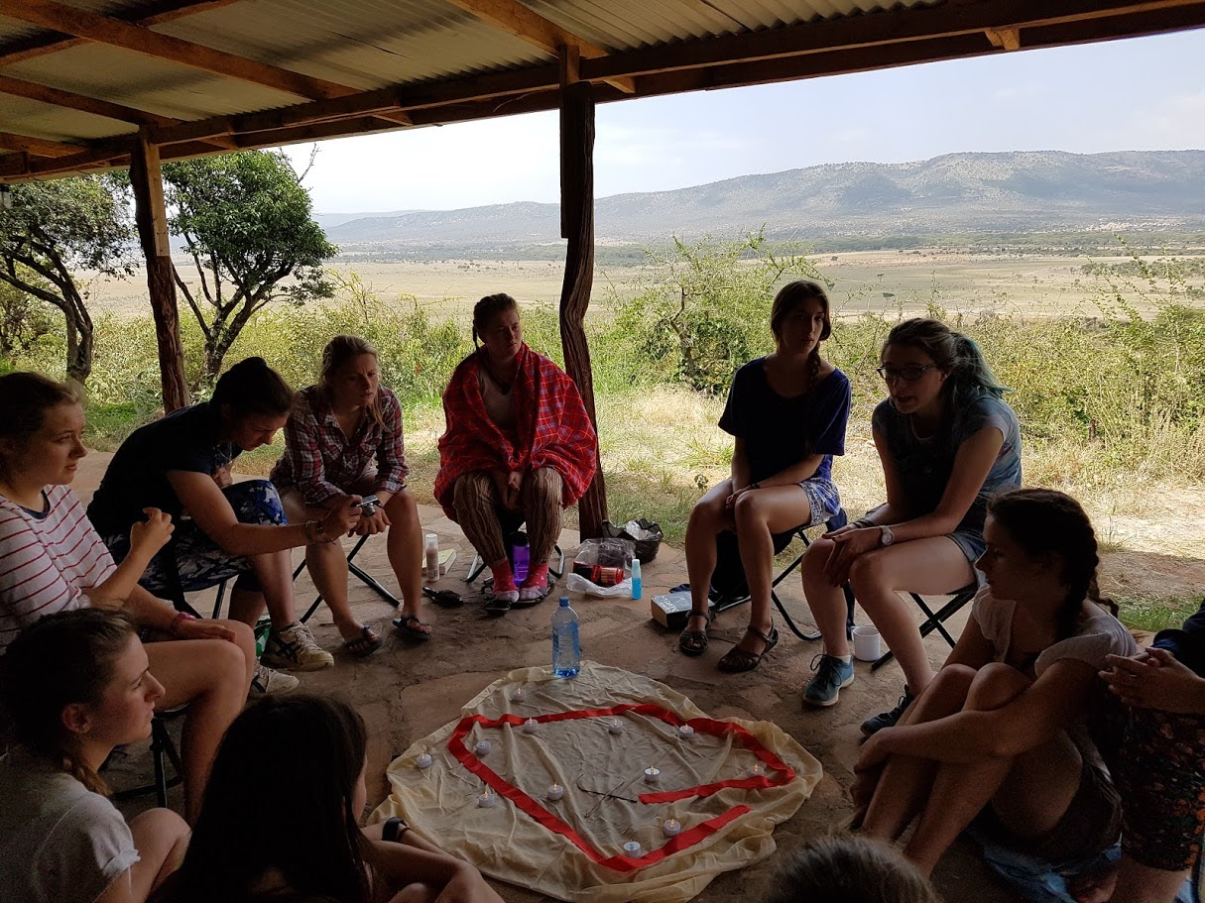
Prayer, reflection and sharing in such a beautiful landscape

