Slide 1
Social Media in Education: opportunities & uses
Be social
Be social
Sagrado Corazón de Placeres
7th October 2017
@_______________
@pelandintecno

Slide 2
Opportunities
Opportunities

Slide 3
People using Internet
In the year 2016, 81% (83% - men & 79% -women) of the spanish population aged 16 to 74 have used the Internet in a clearly upward trend
73,7%
77,9%
80,3%
82,5%
2013
2014
2015
2016
Spain use of Internet (Men) (Source: INE-Instituto Nacional de Estadística)

Slide 4
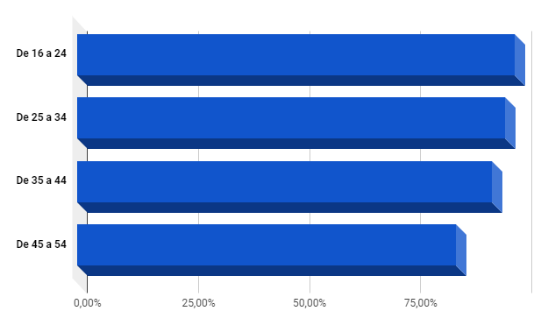
Age distribution of Internet use
The use of the Internet is a majority practice among spanish young people (16-24 years of age), with values around 98%.
Percentage decreases with age. Even so, the percentage of parents of our clients or potential customers (parents under 55 of age) is still clearly over 75%.
These values are slightly lower than the EU average (INE).
Spain use of Internet (Men) (Source: INE-Instituto Nacional de Estadística)

Slide 5
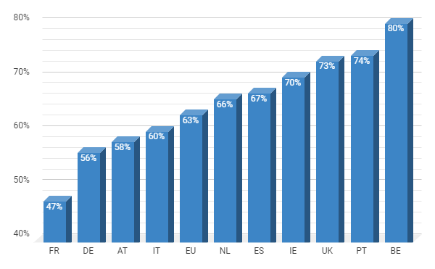
Use of Social Media
In the EU, 63% of internet users aged 16-74 use Social Media services.
Among the young people, almost 88% of Internet users participate in Social Networks, being their principal activity in Internet.
Example: 81% of spanish Internet users aged 16-55 use social networks (> 15 million users)
Source: Are you using social networks? (Eurostat)

Slide 6
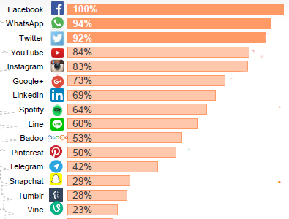
Actual situation of Social Media Spain
Spanish people already attend to 4,8 social networks on average (2017)
LinkedIn stands as the great professional social network.
59% of Twitter users access daily. Twitter is the most intensive Social Media used.
Facebook and WhatsApp are in the first step. Almost everyone uses them.
Twitter stays very far from Facebook, but continues above Instagram
Instagram continues to grow but at slower rate than in recent years.
Source: Estudio Anual de Redes Sociales @IAB_SPAIN

Slide 7
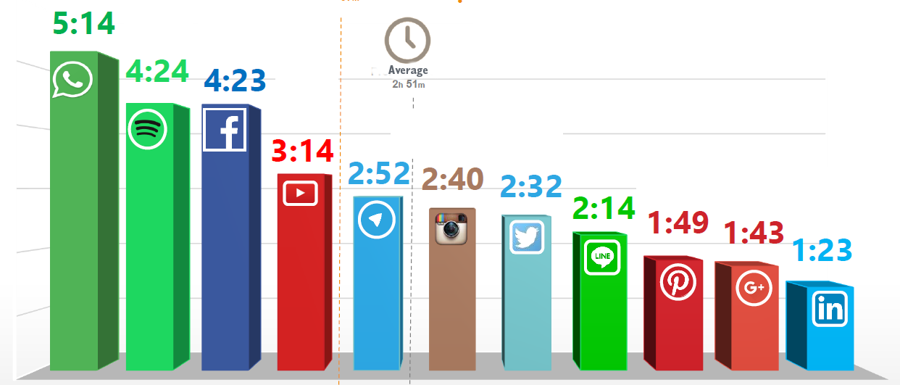
Actual situation of Social Media Spain
hours/week
Source: Estudio Anual de Redes Sociales @IAB_SPAIN
Whatsapp
Pinterest
Spotify
Facebook
Youtube
Telegram
Instagram
Twitter
Line
Google +
LinkedIn

Slide 8
Opportunities in the education field
Marketing tool
Responsive channel for supporting and engaging with students.
Information sources or teaching resources
Comunication, professional development, and collaboration among members of teaching and research staff, information services staff, and administrators.

Slide 9
Social Media as a Marketing Tool
Who hires a service without having previously been informed on the Internet? The answer is simple, almost NOBODY
Be in the right place at the right time.
70% of colleges investing in marketing have more students.
It is indispensable a 100% professional online marketing strategy to catch their interest.
Source:pixabay

Slide 10
Social Media as a Marketing Tool
Inbound marketing
Inbound marketing has proven to be the most successful technique when it comes to educational advertising.
Its main purpose is to contact people, in an non-intrusive-mode, who are in the beginning of the process of buying a particular product (or finding an educational centre). From here, they are accompanied, through the appropriate content for each of the phases of the purchase process and their profile, to the final transaction, and, later, achieve their loyalty...
Traditional marketing
(chase after customers)
Inbound marketing
Always in a "friendly" way

Slide 11
Social Media as a Marketing Tool
Inbound marketing
Inbound marketing makes use of and combines marketing/advertising techniques
content marketing,
SEO (Search Engine Optimization)
social media marketing,
search engine advertising,
web analytics,
email marketing…
….by addressing the user in a NON-INTRUSIVE way and contributing value.

Slide 12
Inbound marketing:
5 basic pillars
PRESENCE: WEBPAGE AND OMNICHANNEL
VISIBILITY FOR EDUCATIONAL MARKETING
SEGMENTATION
ATTRACTION AND CAPTURE
TRANSPARENCY
Notes:
.

Slide 13
Inbound marketing
PRESENCE: WEBPAGE AND OMNICHANNEL
The process starts from attracting ‘strangers’ to view our content and turning them into regular visitors. By improving your website’s you can turn these visitors into loyal customers and school ambassadors.
WEBPAGE must be above all: visual, attractive, practical, mobile responsive (adapted to mobile technologies) and functional.
Omnichannel: User can reach you through a multitude of media. We should offer a professional presence in all channels and formats.
Social networks are indispensable
Online reputation must be monitored to know at all times what is said and where it is said.
Notes:
.

Slide 14
Inbound marketing
2. VISIBILITY FOR EDUCATIONAL MARKETING
Local positioning, for geolocalized searches. The school should appear in local search results and provide all contact information and perfectly updated location.
We must analyze what our online visibility is.
The frequency of publication must be constant so that the search engines reward us with a better positioning and for our community to get used to visiting us regularly.
Notes:
.

Slide 15
Inbound marketing
3. SEGMENTATION
Give each potential client the information they are waiting to receive and the one that can take their decision. Not all candidates have the same priorities and do not value the same concepts in equal measure.
4.ATTRACTION AND CAPTURE
Actually, when there is a very wide variety of options, we must differentiate and be able to produce content that will attract our target audience.
Notes:
.

Slide 16
Inbound marketing
5.TRANSPARENCY
Social networks enable all good things to be quickly known and the least good known at the speed of light.
We must be aware of what is said about our center in the network and put the correction mechanisms in case of identifying criticisms or complaints.
“Social networks rewards the institutions that perform their work best”
Example: Parents will proudly share the results of their children's school. They then become ambassadors for our institutions online.
Notes:
.

Slide 17
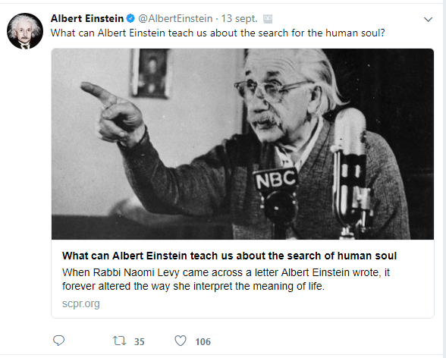
Social Media as a channel for supporting and engaging with students
Most students are more motivated and will do it much better if they are allowed to use social media.
It´s time to start working with social media as opposed to fighting against it.
“Meet Your Students Where They Are”
Last minute news, and class updates
Participate in debates about a matter
Contact with foreign-speaking students
Take the role of a historical character (@MrNikola_Tesla, @isaac_newton, @AlbertEinstein…)
State up to date of institutions news (@EU_Commission, @NASA, @Pontifex...

Slide 18
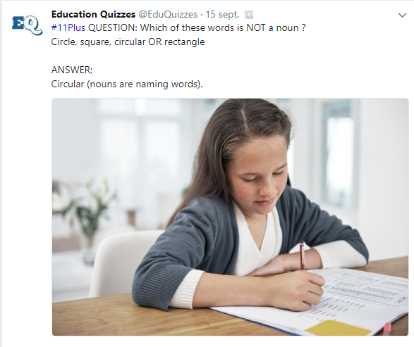
Social Media as a channel for supporting and engaging with students
“Find ways that you can benefit
from social media and it will help you motivate your students!”
Summarize texts (140/280 characters)
Write a story
Follow school events: trips, holidays...
Conduct Surveys (Polls)
Quizzes
Create your own newspaper or magazine
Content Curator (Search, classify, filter & add value)

Slide 19
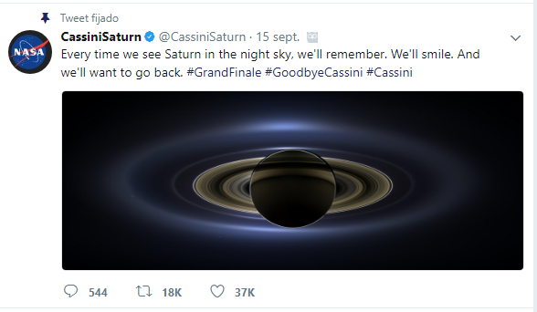
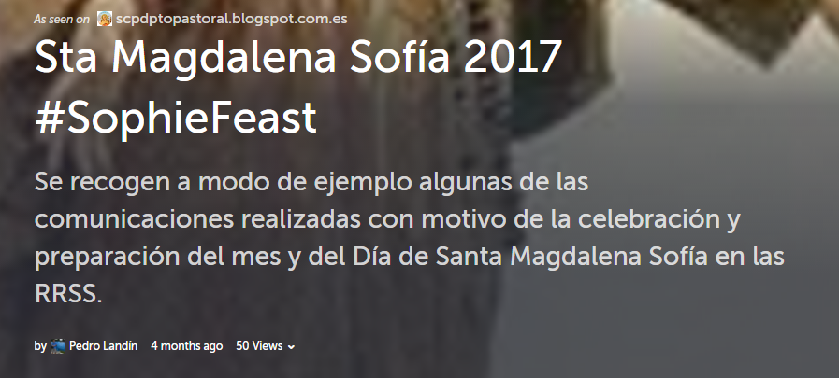
Social media as information sources or teaching resources
Connect with experts on the topic
Be part of Social Media communities
Search for links to blogs or other content sources.
Follow current events: Rossetta landing, Cassini’s Grand Finale, elections, wars, world crisis, sport events…
Enrich the PLE (Personal Learning Environment)

Slide 20
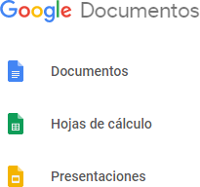
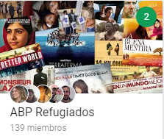
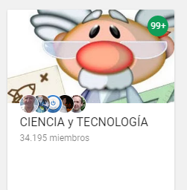
Social media as Communication, professional development, and collaboration tool
Collaborative works (documents, presentations, maps, blogs, webpages….)
Collaboration with other educational centers
Twitter and Whatsapp Lists (Colegios RSCJ España…)
G+ communities about a particular interest
Youtube channel (scpmatematicas…)
Twitter List

Slide 21
Risks of Social
Media

Slide 22
The dangers of Social Networking
Social Media was not created for evil purposes but, like anything, it can be misused
Age limit: EU legislation states a minimum age of 16 years in order to use Social Media. However, each Member State establishes its own (the lower limit is 13 years), so it is “no allowed” for students of lower ages.
Should we educate our pupils in Social Media behaviours?
Always with a written parental/guardian consent

Slide 23
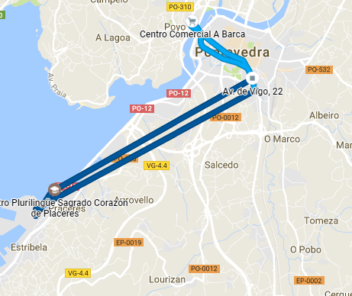
The dangers of Social Networking
Access to inappropriate content
Information overloaded: Open systems produce a lot of noise. It can be partially solved by using hashtags, list, communities, filters...
Isolation: decrease of direct relationships
Dependence: The instantaneity of communication in Social Networks can generate a need for immediate response. When we receive a message we do not have to answer at the same time.
All info last forever
Students/teachers are exposed to a number of hazards if proper precautions are not taken to avoid cases such as:
Grooming
Cyberbullying
Sexting
Privacy lost
Identity theft
Technology addiction...

Slide 24
Good Practices

Slide 25
Social Media some guidelines
Keep professional and personal accounts separated
Always keep your target audience in mind.
Beware of automation.
Respond to comments quickly, especially if they are negative (No ignore or delete): You may not be always right. In social networks anyone must be willing to offer apologies and rectify. Assume your own mistakes.

Slide 26
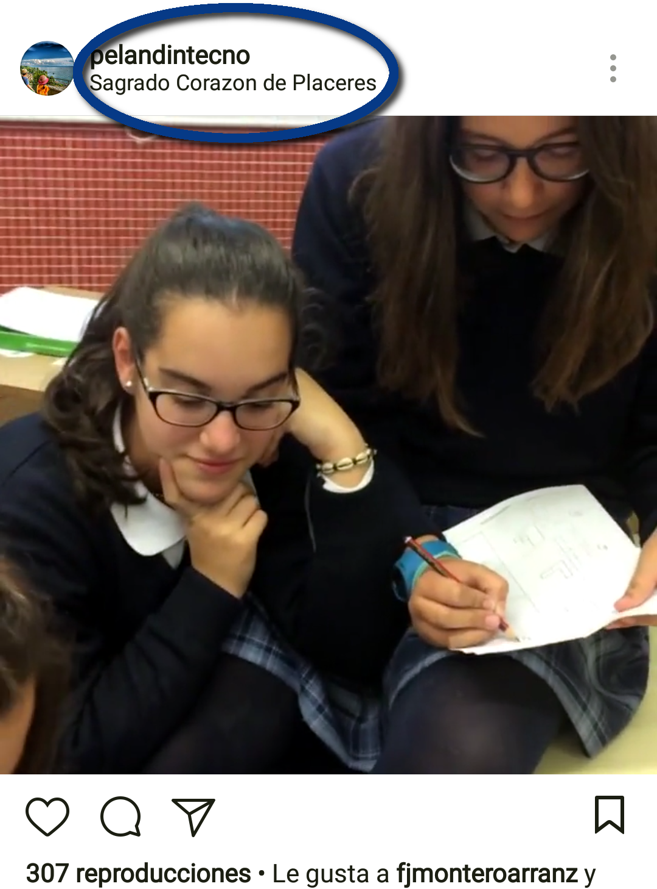
Social Media some guidelines
Maximize the ability to share your social messaging:
Geolocation of the messages, quality images, videos…
Hashtags: Build a brand, follow a campaign or a topic, make content relevant...
Share constantly 24/7 but be aware of overburdening
Control your hashtags: Use your hashtag in moderation and choose them carefully. Your hashtag should help you engage in a broader conversation or direct you to a specific audience, without forcing your audience to reconsider their decision to follow you.

Slide 27
Social Media some guidelines
Don’t send spam to your followers
Do not talk badly about your competitors. Don´t be rude.
Be aware of the numbers: Number of followers should no longer be your main key performance indicator (Robots, false acounts…)
Follow accounts that build valuable content that you would consider sharing as part of your content strategy
Know the specific Netiquette of the Social Media you are going to use.

Slide 28
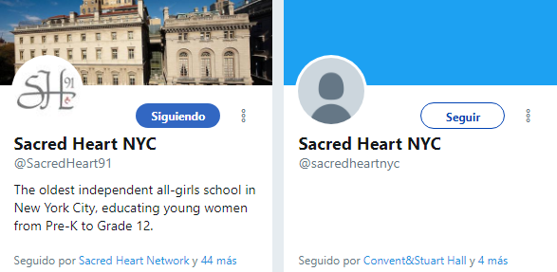
Example: Twitter basic rules of behavior
Optimize Your Twitter Bio:
Picture profile (NO EGG/NO DUMMY)
Brief description,
Link to landing page and other social channels
Monitor Twitter for any mention of your company
Interact with your followers: ask them and, of course, always answer them
Tweet a regular supply of relevant, useful content
Retweet great posts from others, and give them credit.
Respond immediately
Give more than you receive

Slide 29
Example: Twitter basic rules of behavior
Take care of your spelling
DO NOT USE CAPITAL LETTERS, they are "aggressive"
Thank when they start following you (DM), when RT your content or when they recommend you.
Use hashtags and images to increase reach (max 3 hashtag / message):
Maintain a Schedule & Checklist before post
Follow people or companies that really are interesting, without expecting anything in return

Slide 30
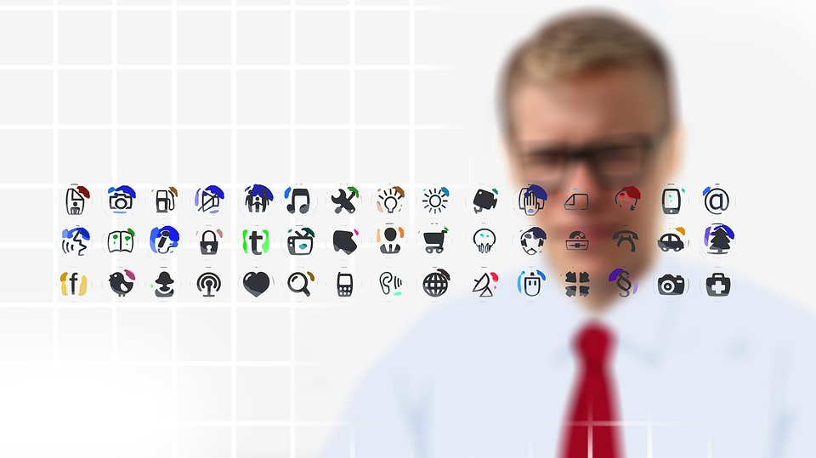
Who is in charge??
Community Manager

Slide 31
Community Manager role
In order to select and manage the numerous Social Media in which an Educationtal Center should be present, each institution should have a person in charge of: the Community Manager
He/she is the professional in charge of
CREATING,
MANAGING,
MAINTAINING, and
GROWING
the social community of the institution for which he works

Slide 32
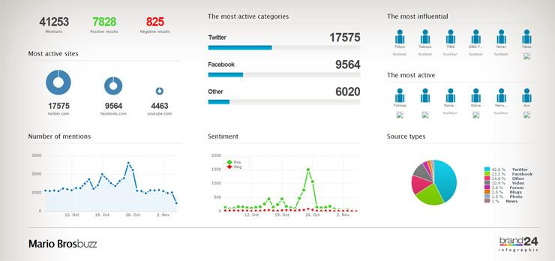
Community Manager role
LISTEN & MONITOR
Find out what people are saying about your educational center (analytics tools).
Communicate to the institution the data that has been compiled from the "listening" of the network.
Get ahead of information demands of the educational community and offering such information
Be attentive to the creation of opportunities for the center abroad

Slide 33
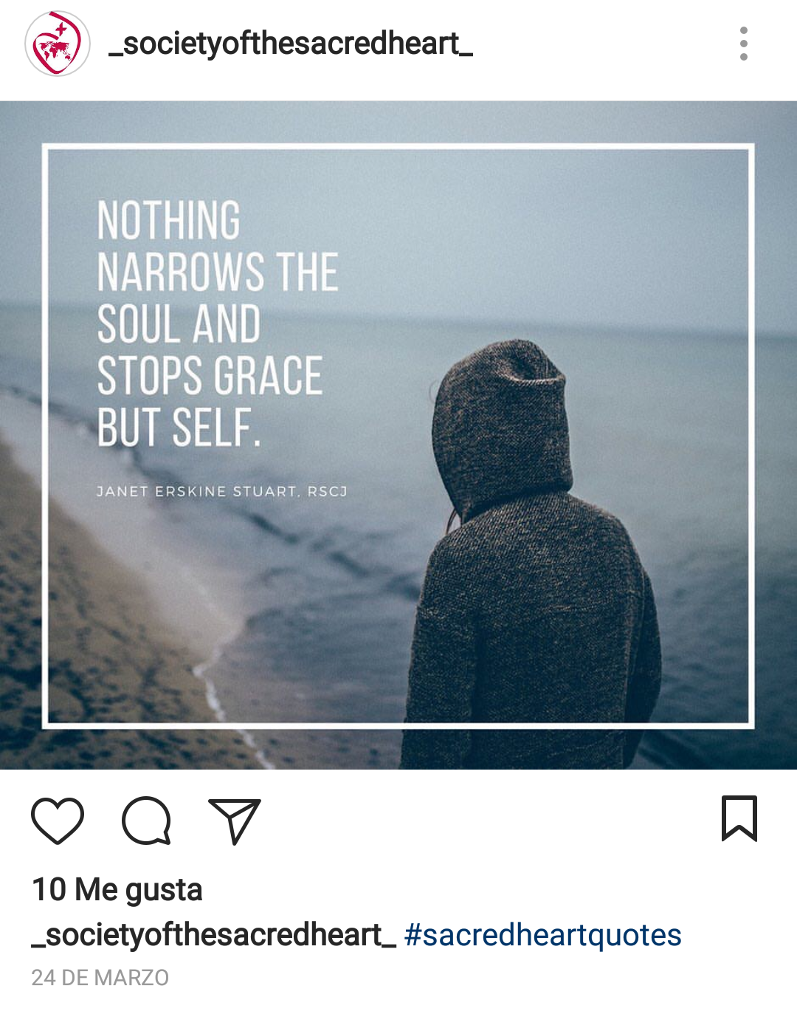
Community Manager role
CURATE & CREATE
Help to create and manage an institution’s online communities.
Select, filter and give value to information to be spread (curent curator).
Creating attractive and quality content (Social Media, landing page, blogs, images…).
Establish relationships and communications with different groups within the institution.

Slide 34
Community Manager role
ENGAGE
Engage with customers and fans: Constant publication.
Use Social Media and events to help increase school loyalty.
Empowering users to become school ambassadors.
Be a part of client’s digital life.

Slide 35
Community Manager role
CHAT
Manage and monitor institution’s comunications
Actively talk and answer in all the plataforms to the community (Should be the digital voice of the school-¿authority?).
Participate in Educational communities

Slide 36
Twitter RSCJ profiles
Sacred Heart Network @NSacredHeartS
Network SH Schools @NetworkSH ‏‏
We Are Sacred Heart @WeAreRSCJ ‏
RSCJ sisters ENW @heartintheworld
St Madeleine Sophie @StMSophieBarat
RSCJ USC Province @RSCJUSC
RSCJANZ @RSCJANZ
Sacred Heart (Tokyo) @ISSHTokyo ‏
Sacred Heart Ed @Sacredhearthh ‏
Sacredheartmalta @Sacredheartmalt ‏
AMASC@SacreCoeurAlum
AASH @AASHSacredHeart
Barat Spirituality@BaratSC ‏
Cuisine du Coeur @CuisineduCoeur
RSCJ Associates USC @RSCJAssociates
@sacredheartsch7
SCCGoals @goalsSCC
MSC Goals @GoalsMsc ‏
HOUSE OF BARAT 1800 @Barat1800 ‏
SHHS Hammersmith @SHHSHammersmith ‏
Beechwood SH School @SchoolBsh
Mount St Catherine's @MSCArmagh
stcatherinesarmagh @stcatherines247
Mount Anville @mtanville
Gaeilge@StCatherines @GaeilgeStCather
Sacred Heart Primary @sacredheart_roe
stjosephsprimary @stjosephsabn
Sacredheart Aberdeen @stjoesshgoals ‏
Sacred Heart Roscrea @SacredHRoscrea
Sacré Coeur Wien @gymscwien
Sacré-Cœur Amiens@SacreCoeurAm
Digby Stuart College @DigbyCollege
Woldingham School @WoldinghamSch
Kairos Centre @shhschaplaincy ‏
rscjenEspana @rscjenEspana
Red Sagrado Corazón @redscj
CSC Granada @CSC_Granada
Sta María del Valle @SCElValle
Sagrado Corazón Pamp @SagCorPamplona
Sagrat Cor Sarrià @SagratCorSarria
Sgdo Corazón Ftv @SgdoCorazonFtv
CSCChamartín @cscchamartin
Sagrado Corazon Cham @Brujuleo
Sagrat Cor - FECIB @SagratCorFECIB
Sta. Magdalena Sofía @smsofiazaragoza
Colegio SCFerraz @scrjferraz

Slide 37
Time to work

Slide 38
Workshop Activities: Ideas
Create a G+ Community of Headteachers
Review of Schools Profiles in different Social Media
Create Twitter List
Share pictures of the Meeting (Geolocated) with the hashtag #SCP_EU17
Create a Collaborative Google Maps of the Schools
Debate the paper of de Community manager

Slide 39
References
Inbound Marketing
Inbound marketing para organizaciones educativas [+Guía]
Inbound Marketing: ¿Qué es? Origen, metodología y filosofía
Ciencia, tecnología, sociedad de la información: Población que usa Internet (INE)
Estudio Anual de Redes Sociales @IAB_SPAIN
Are you using social networks? (Eurostat)
6 consejos para usar Twitter como herramienta educativa
Pixabay.com
Instituto Nacional de Ciberseguridad España (OSI)
¿Cómo podemos usar Twitter con nuestros alumnos?
TIC y Formación
Guía usos y estilo en las redes sociales de la junta de castilla y león
La importancia de las Redes sociales en el ámbito educativo - SeDiCI

Slide 40
Decálogo para el uso responsable de Twitter (Peter y Twitter) de Pantallas Amigas
30 abreviaturas para sobrevivir en Twitter #Infografía
15 Herramientas para Community Managers que harán tu trabajo más fácil
18 formas de enseñar y aprender con Twitter en el aula TIC
What to tweet?
10 razones para usar Twitter en educación
28 ideas para usar Twitter en la enseñanza
Guía práctica para el uso de RRSS en instituciones

Slide 41
@pelandintecno

