Slide 1
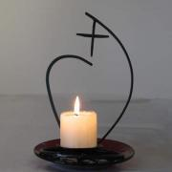
We participate in the mission of the Church
through the service of education
which is our way of continuing the work of Christ.
This service of education and instruction is directed chiefly towards the young and those who bear within them the future of the world.
Caught up as we are in the desires of His Heart,
we want people to grow in dignity, as human beings
and as children of God
Our starting point is the Gospel
with all that it demands from us of love, forgiveness
and justice,
and of solidarity with those who are poor
and rejected by the world. (7)

Slide 2
JPIC and the Chapter of 2016
To be One Body which loves, practices and gives witness to justice, peace and integrity of creation at all levels of our life and mission.
Province/Region/International
Formation for understanding JPIC including Laudato Si
To have an attitude of openness and a critical mind for what happens in our world
Taking a prophetic position in both “denouncing” and “announcing” about issues
Ensuring that the whole Society is included in the Mapping project*
JPIC international meeting takes place within the next two years in response to the General Chapter Calls

Slide 3
Communication implications for the web, UN, resources-sharing, JPIC as a Body
Moving to new frontiers, for example, risk new forms of mission and flexibility about forms of mission
Implications for education in all its forms
Engaging with international Volunteers network
Implications for the sharing of resources: human and economic
Responsibility for personal and community simplicity in our life.

Slide 4
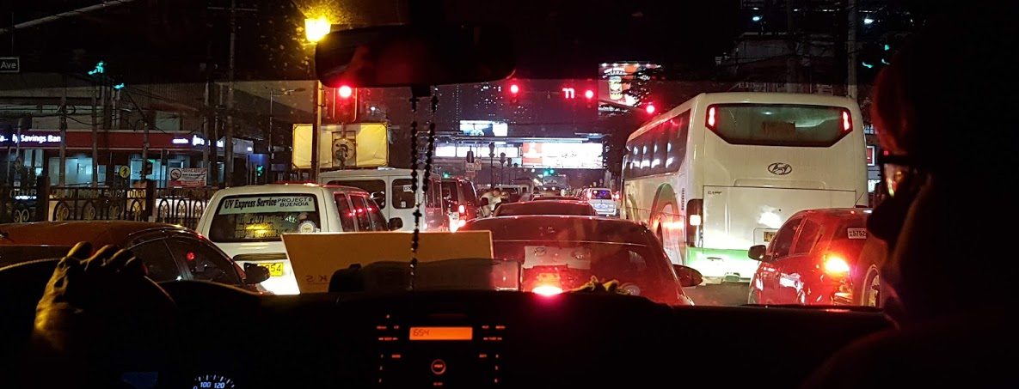
Manila Immersion
The Traffic!

Slide 5
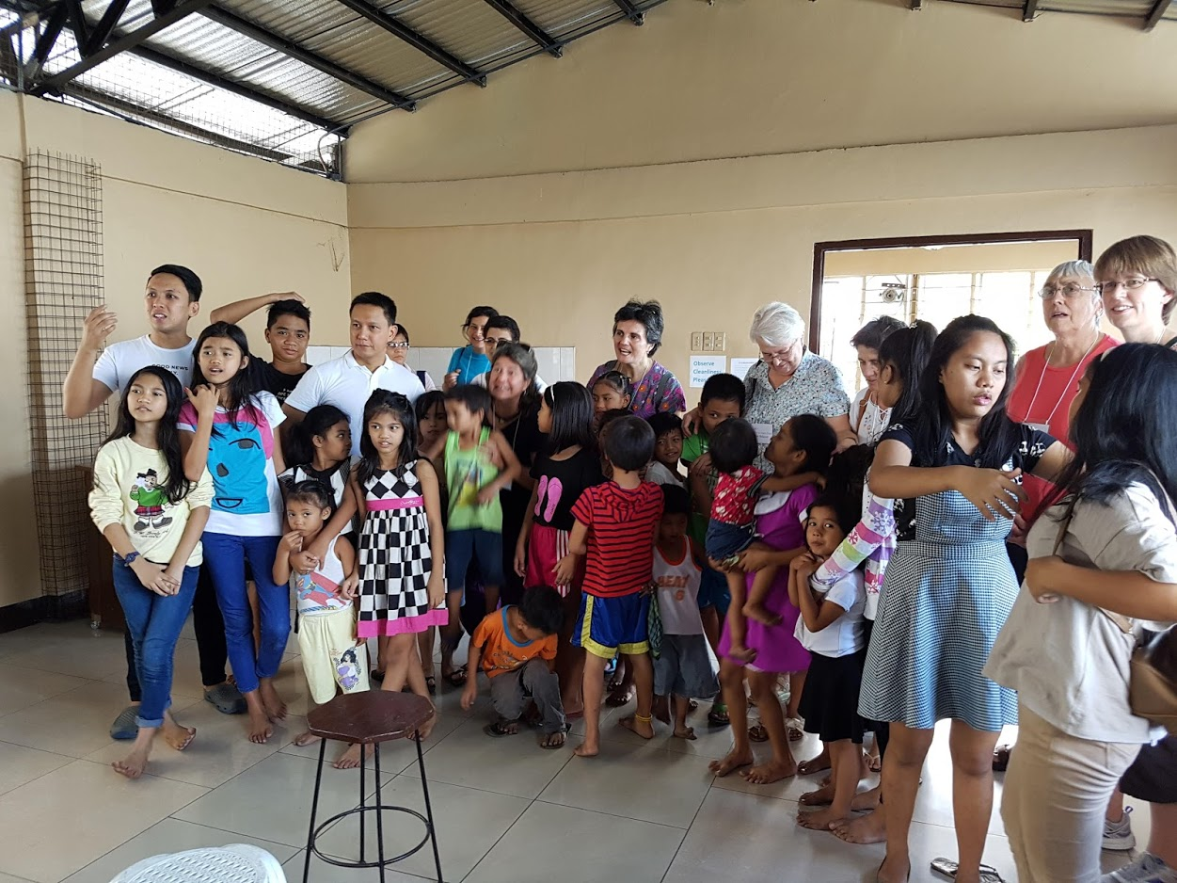
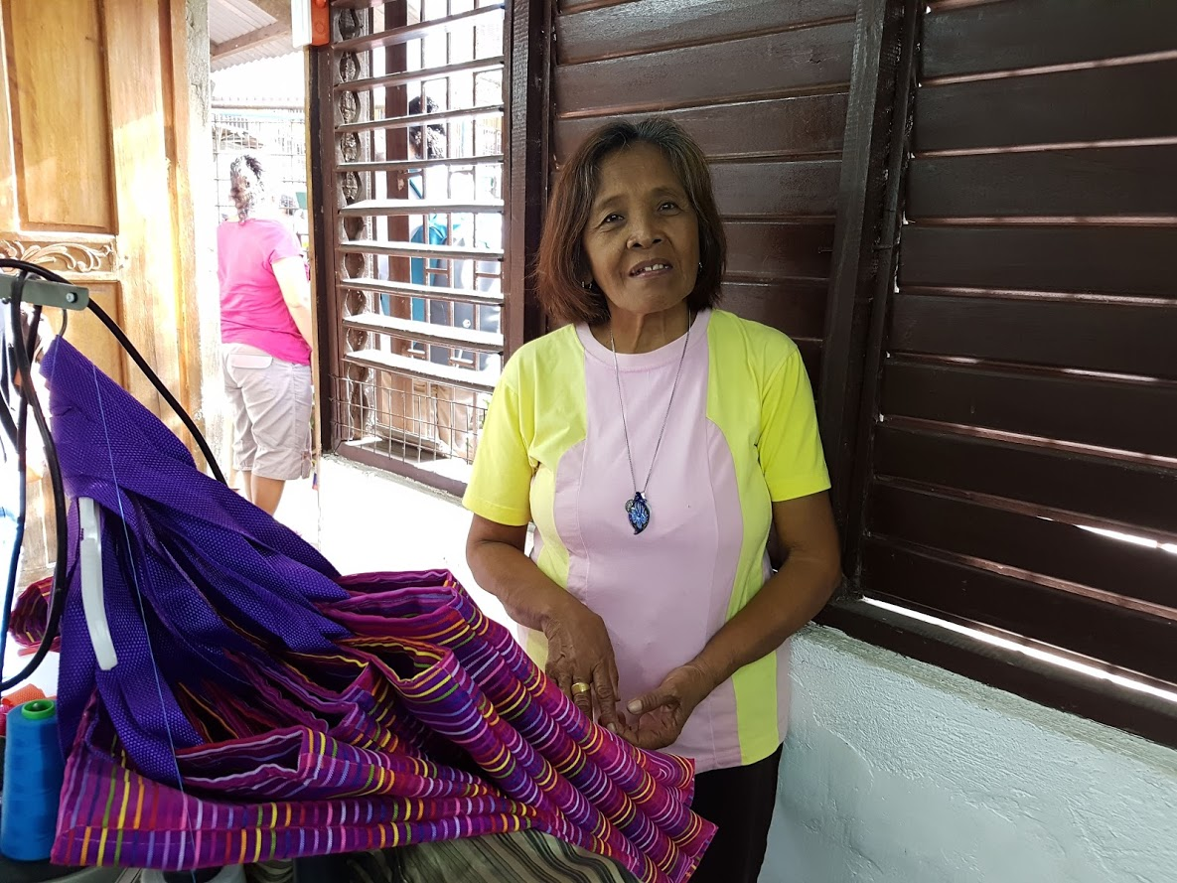
The Vincentian Parish
A project to support families effected by the unaccountable shooting to kill of suspected drug dealers…

Slide 6
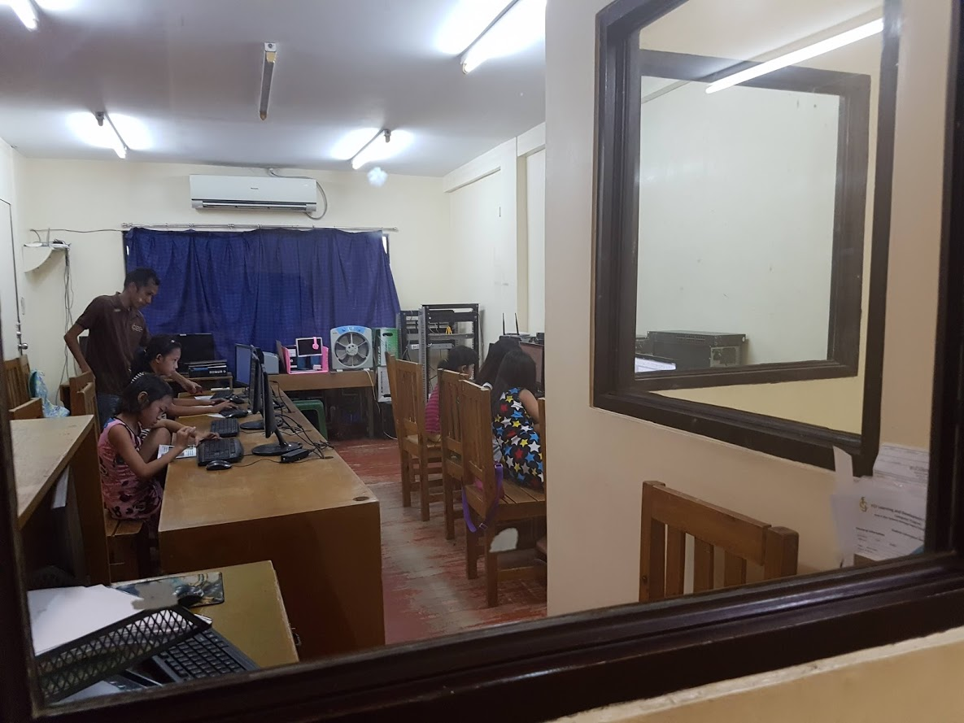
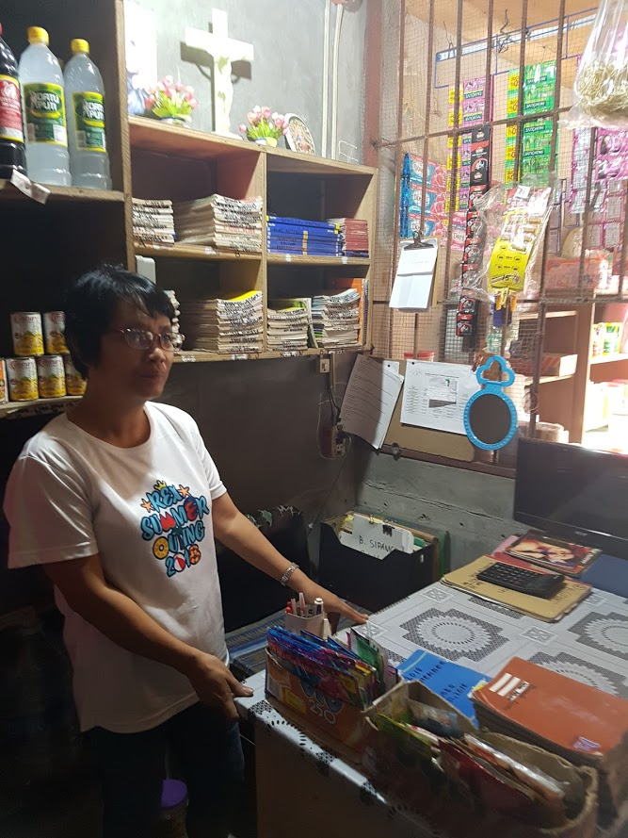
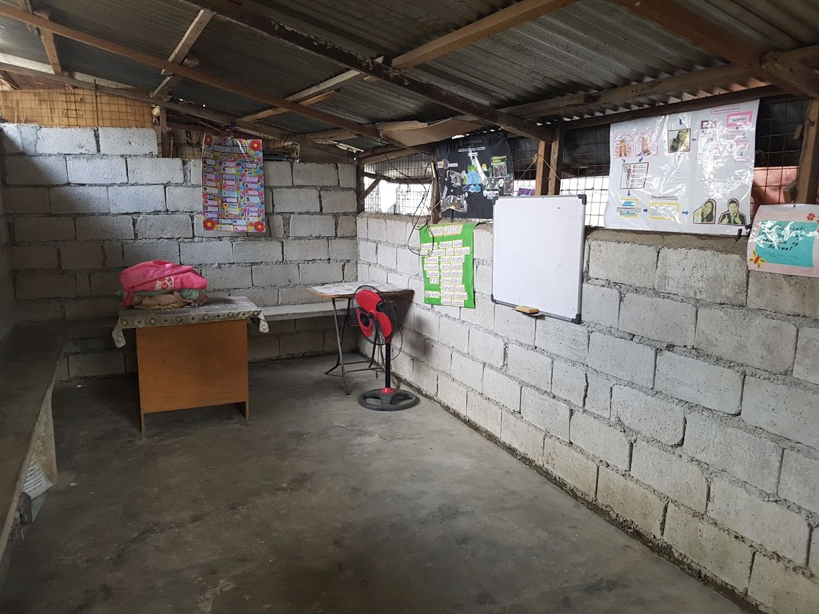
FCJ Project: supporting communities in all kinds of ways

Slide 7
The Good Shepherd Sisters’ Projects

Slide 8
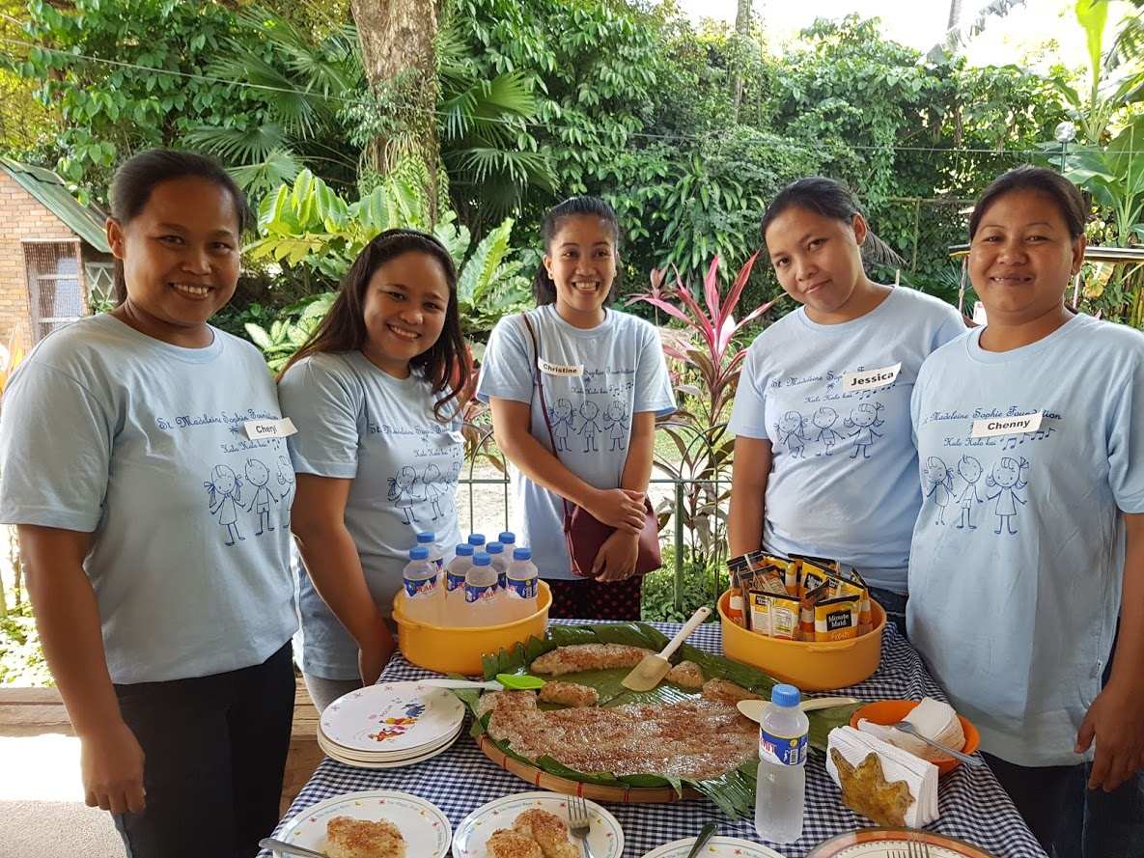
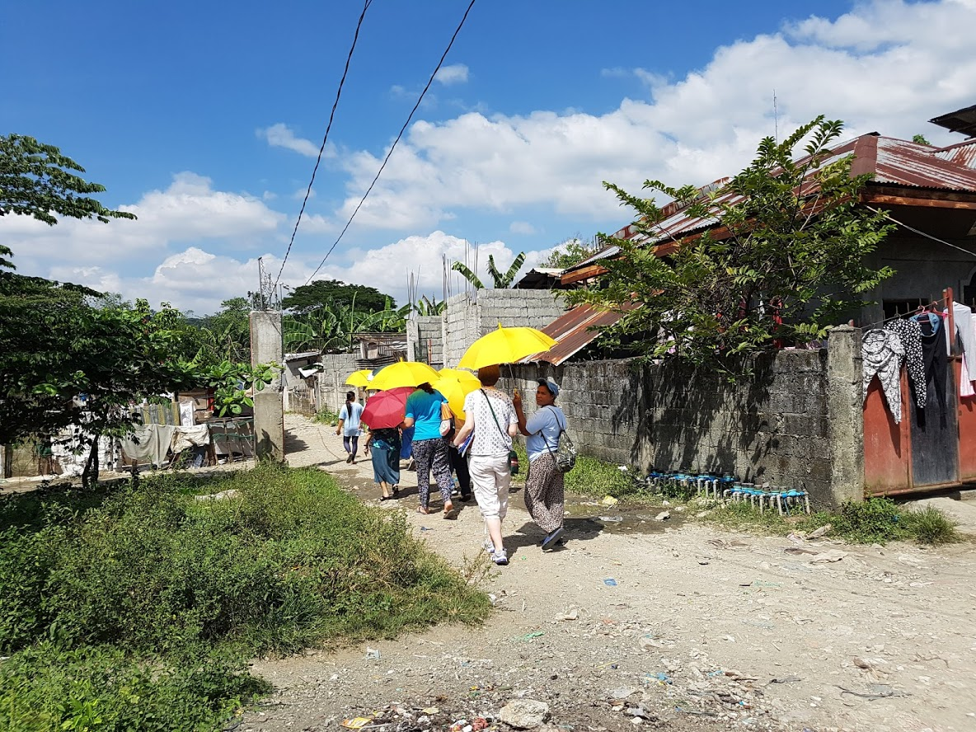
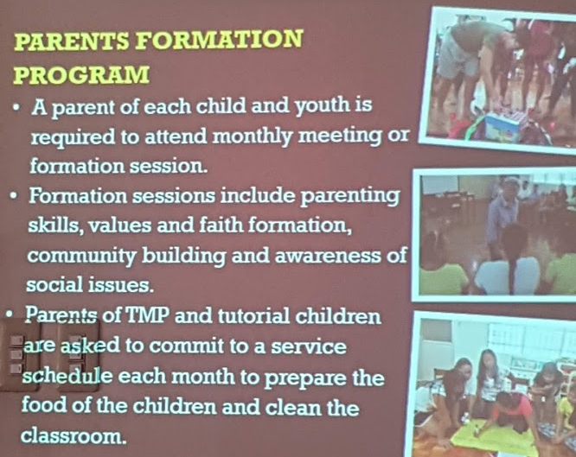
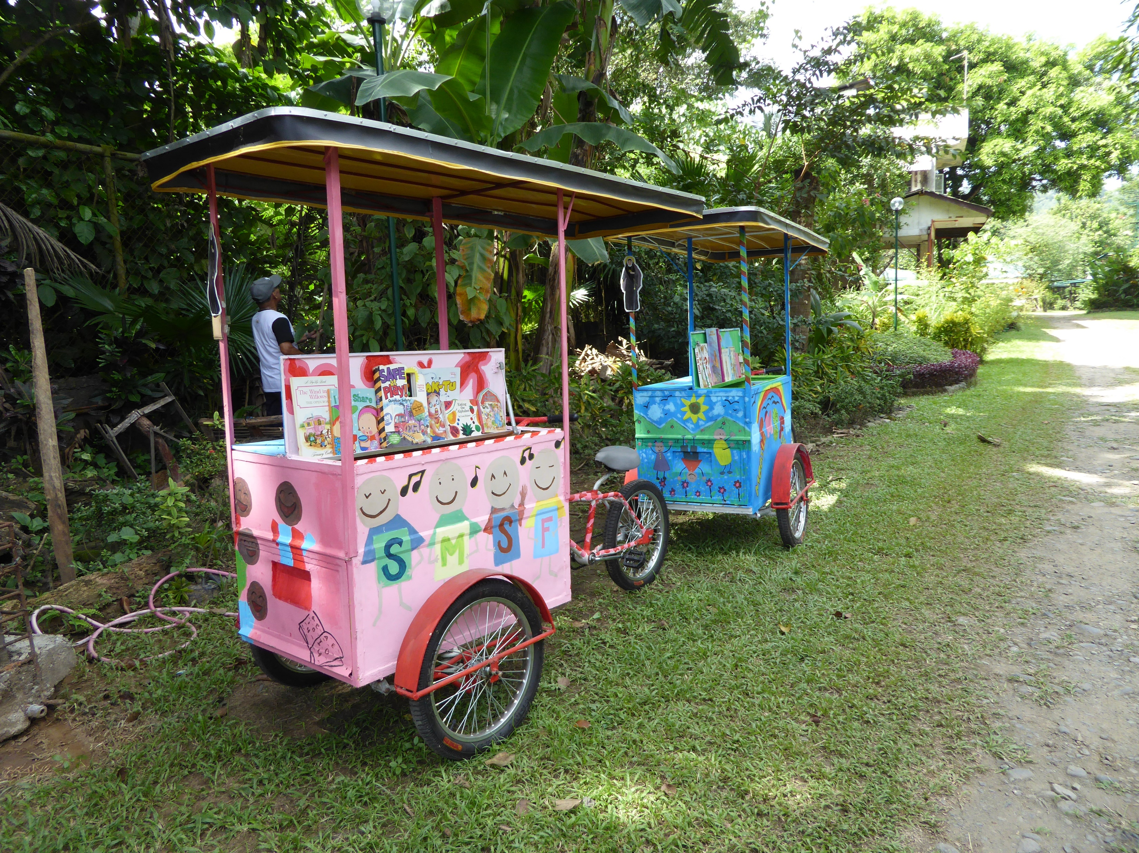
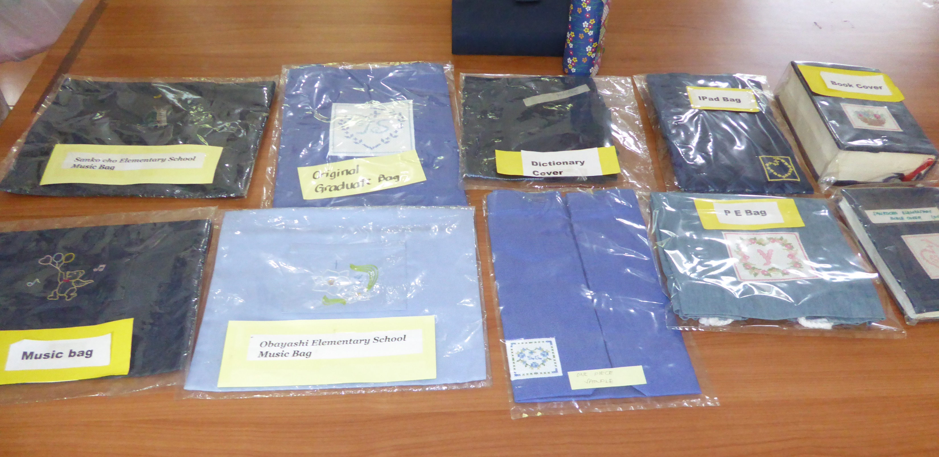
St Madeleine Sophie Foundation “What is SMSF for you?” She answered, “SMSF is a bridge for the poor people to have a new hope in life. At SMSF, I don't feel that I'm just one of many; rather, I feel loved as a member of a family.”

Slide 10
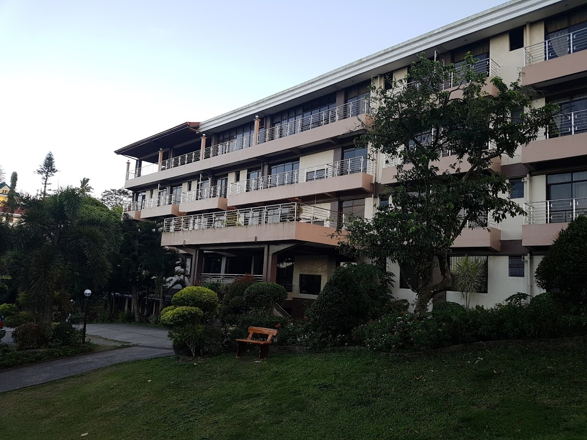
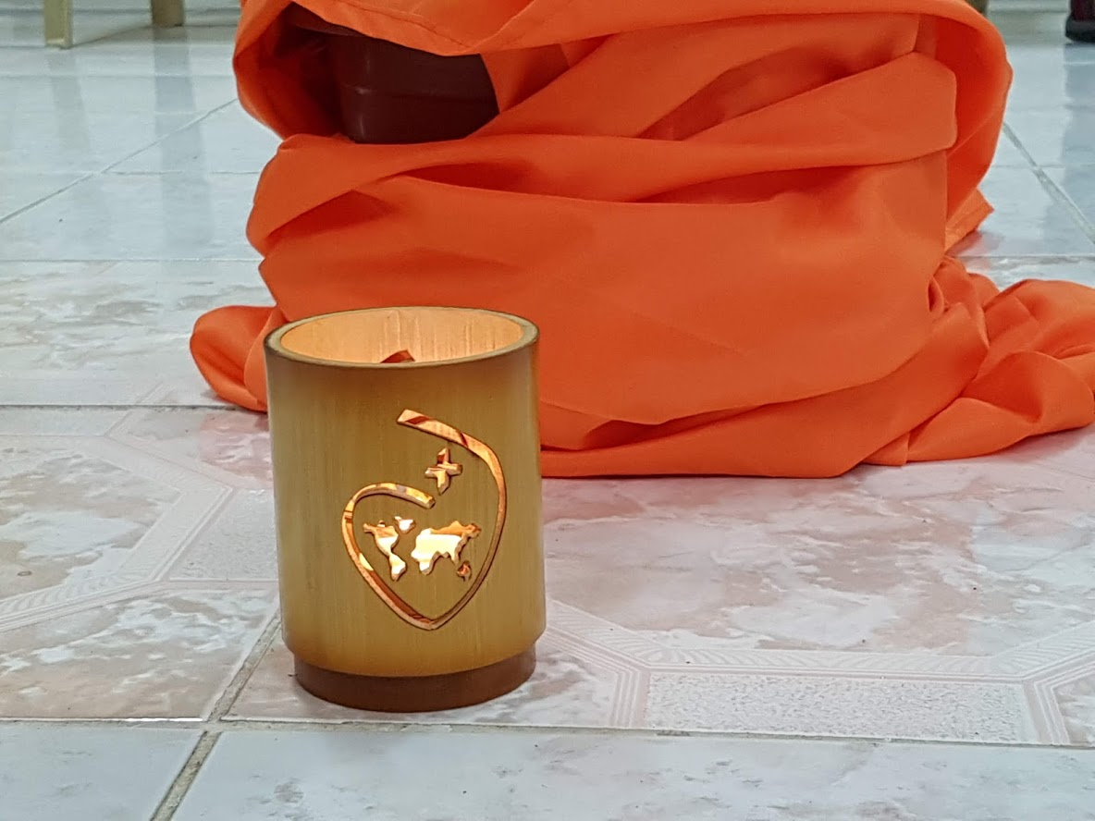
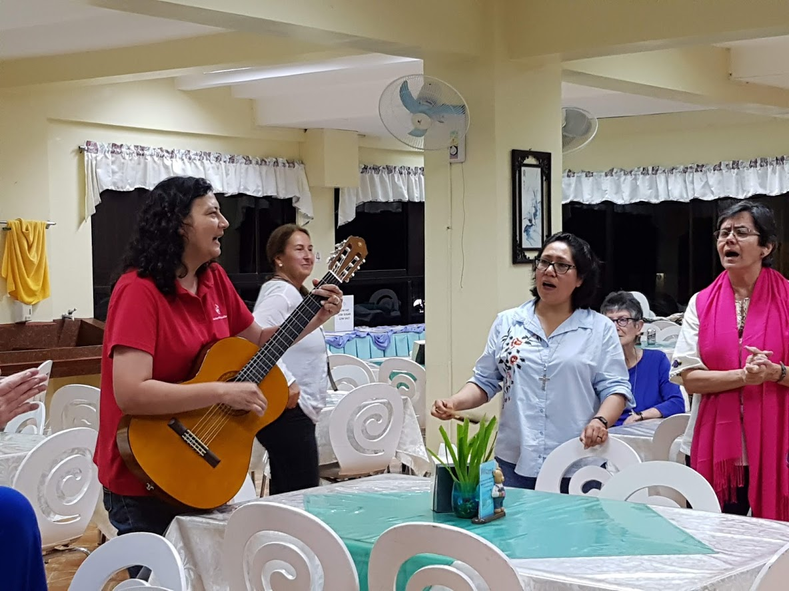
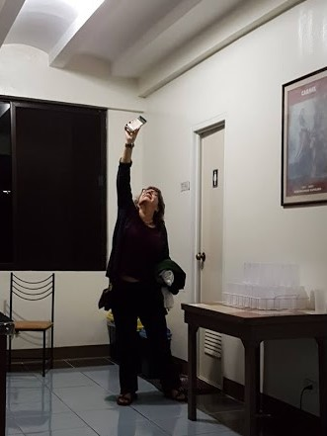
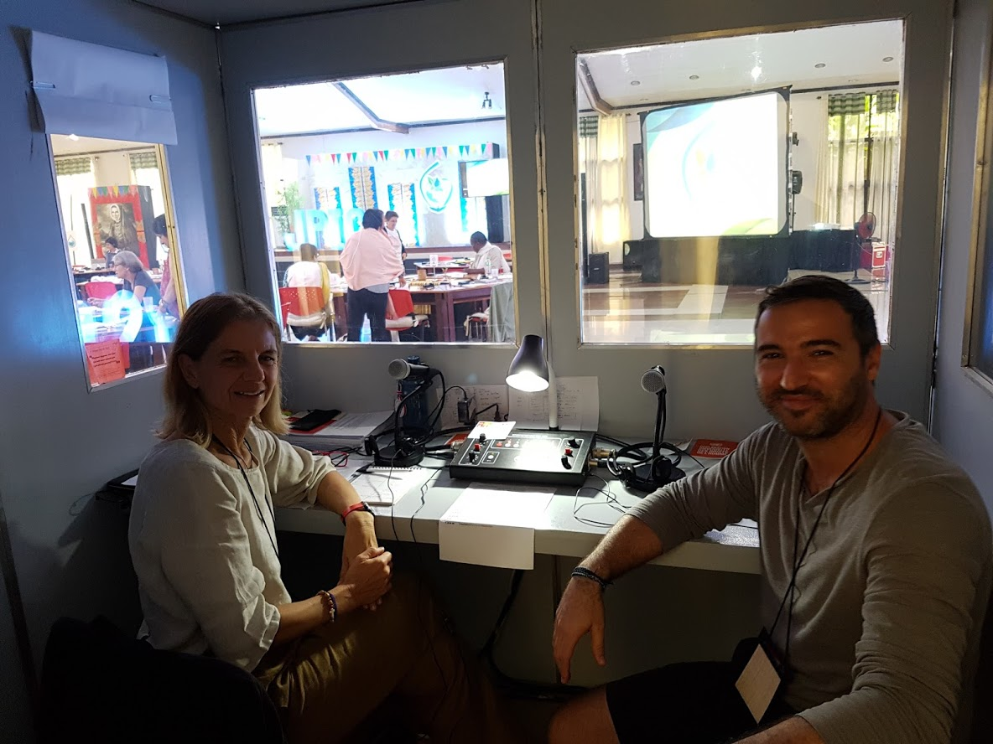
Who was there
A typical day
Delegates (44 RSCJ, 3 lay):
29 Province Representatives
(from 24 provinces)
4 Commission Representatives
JPIC Committee (6)
2 Facilitators
General Council (6)
Support Staff
3 translators & 6 interpreters
5 RSCJ from PHI & KOC
2 Web team
6.30am Mass
7.00am Breakfast
8.00am Morning Prayer
8.30 am Meeting
10.00am Snacks
10.30am Meeting
12 noon Lunch
2.00pm Meeting
4.00pm Snacks
4.30pm Meeting
6.30pm Supper
7.30pm Evening Prayer
8.00pm Evening Presentation (some evenings)

Slide 11
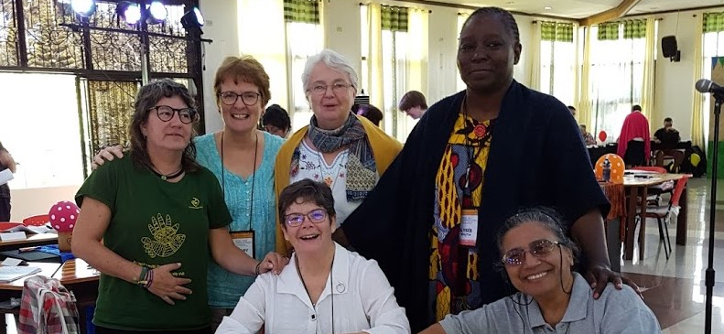
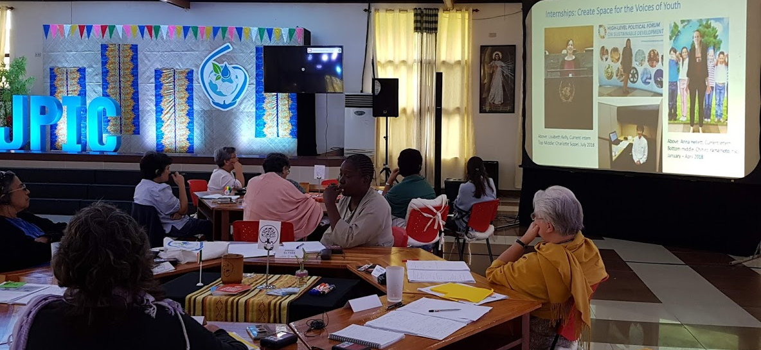
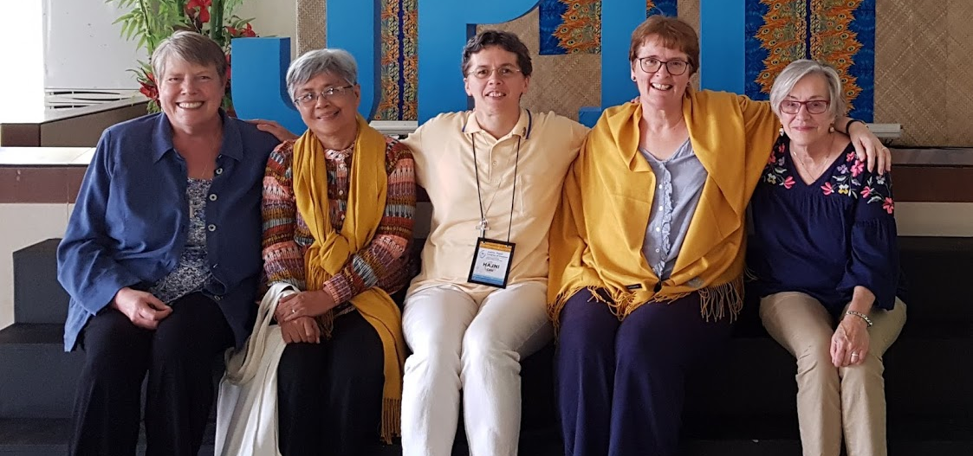
The Process
The Cave
Base groups
Vulnerabilities and Compassion
Presentations via Zoom!
The History of JPIC in the Society
The UN-NGO presentation
JPIC Data base
Discussion in Regions re current projects
Beginning to identify the emerging themes
Theme groups
Identifying objectives, possible lines of action

Slide 12
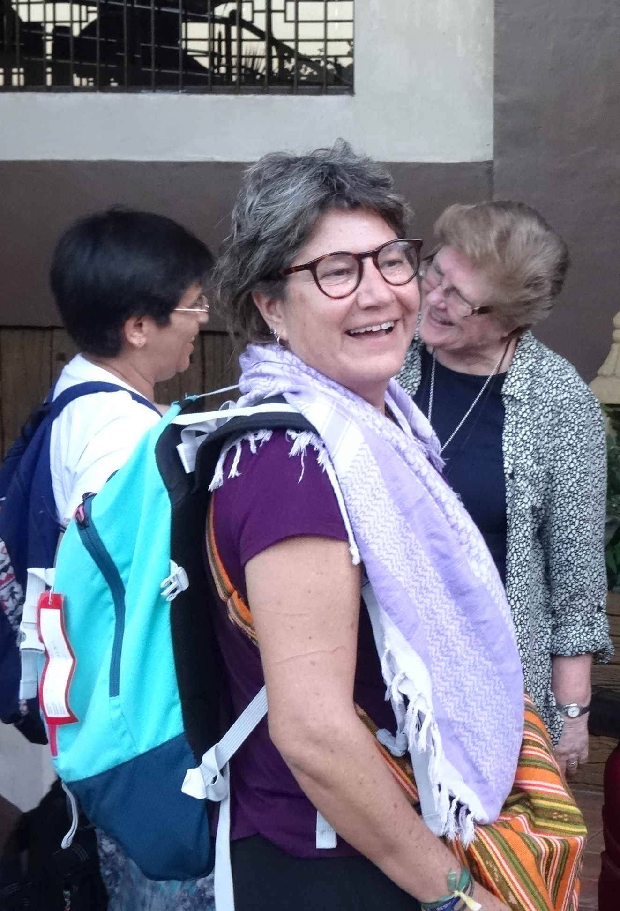
Montse Pratt, Morocco
Espacio Mujer – Women’s Space
To offer a space where sub-Saharan women living in Tetouan find themselves welcomed and trusted, feel listened to, can build relationships with other women and be able to expand their potentialities.

Slide 13
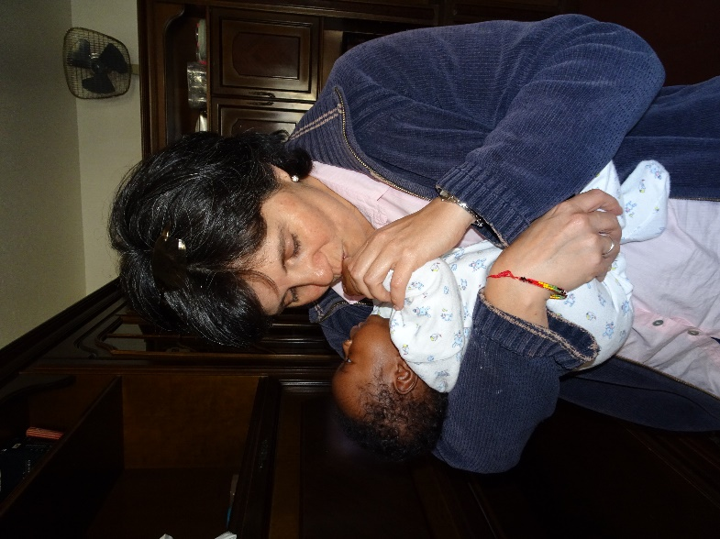
Fatima Santalo-Ossorio – Almeria, Spain
In the southern Spanish village of Las Norias de Daza, in the region of Almeria, 57.2% of the population are migrants. Most of them are newly arrived and work in greenhouses.
The Bantaba centre wants to be a place of encounter and relationship for migrants and between the local populations. Bantaba's main objective is the integration of the migrant population at local level.
They run Spanish lessons, computing lessons and counselling.

Slide 14
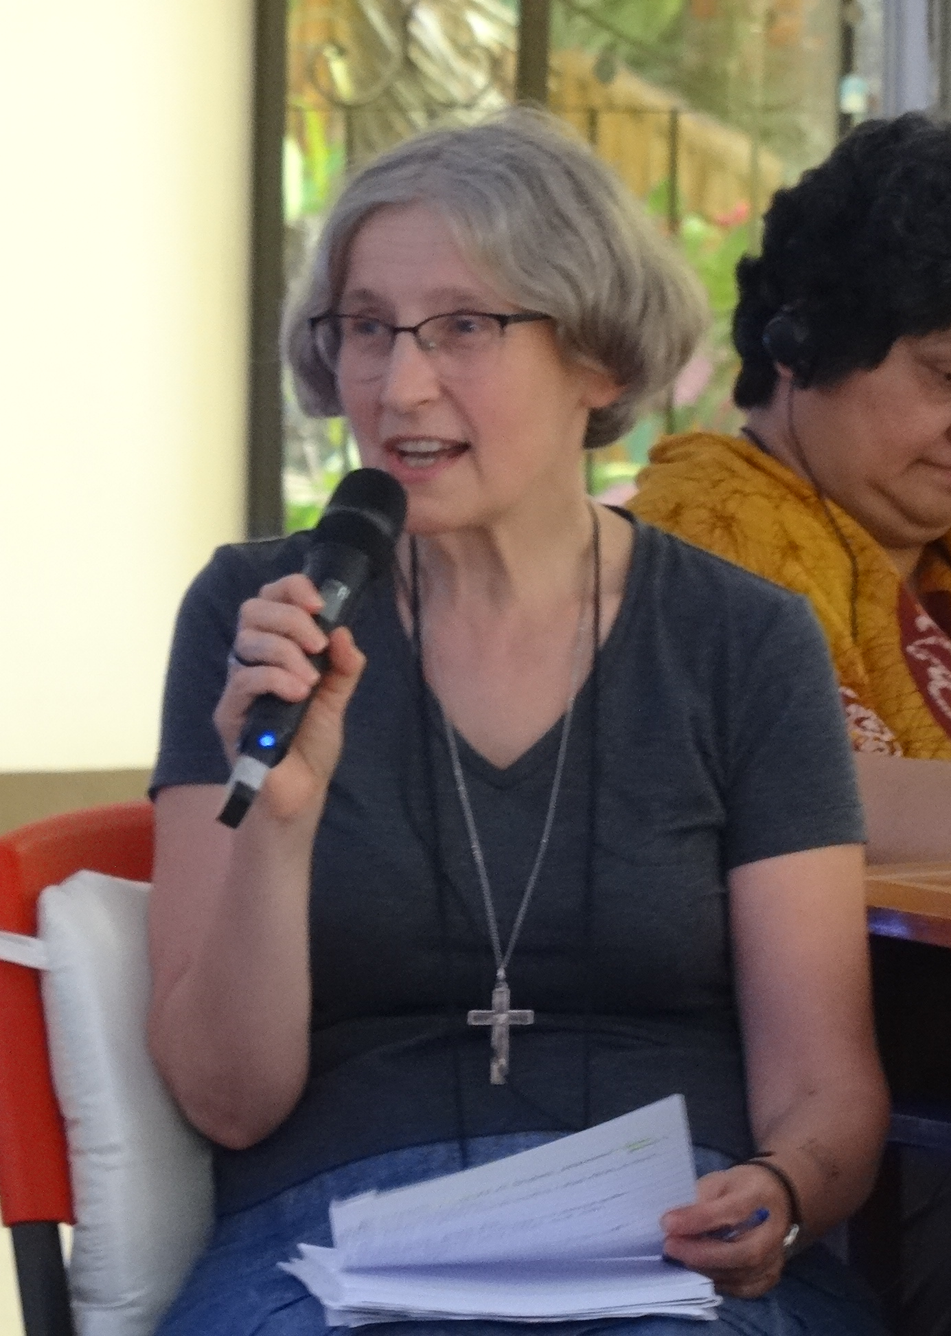
Viola Zajac – Youth Sociotherapy Centre, Poland
Support and teaching for young people at risk especially those with learning difficulties because of family and social problems.
The Centre provides care for pregnant teenagers, young people from different nations, cultures and religions and young people with addictions.
The aim is to create a conducive environment what will provide specialised pedagogical and psychological assistance/therapy to young people who are burdened with severe problems.

Slide 15
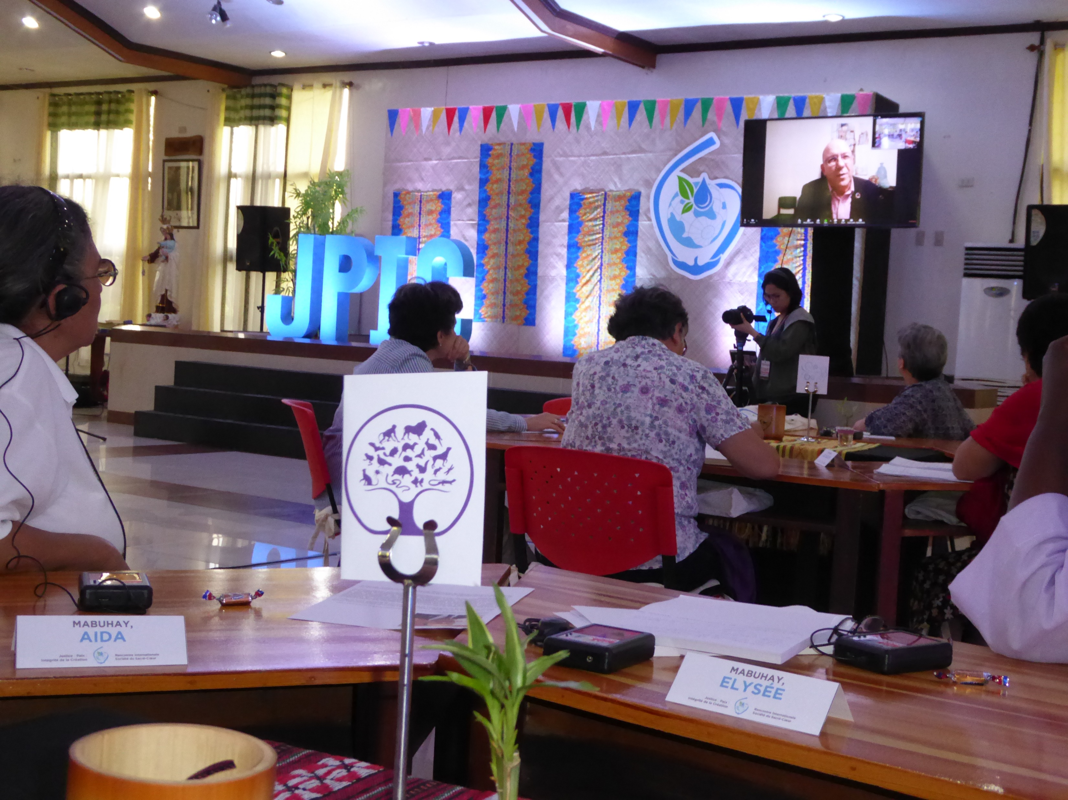
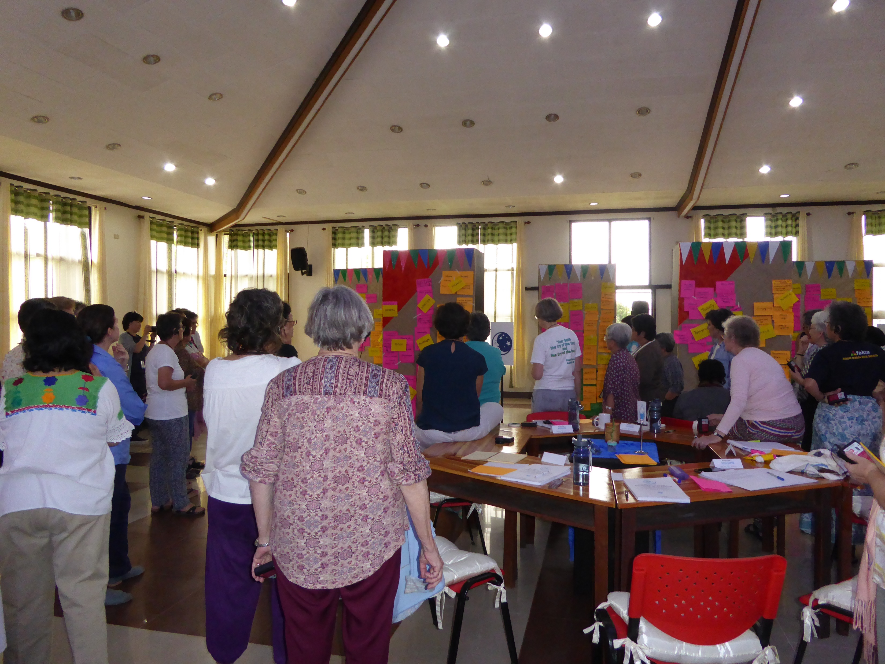

Slide 16
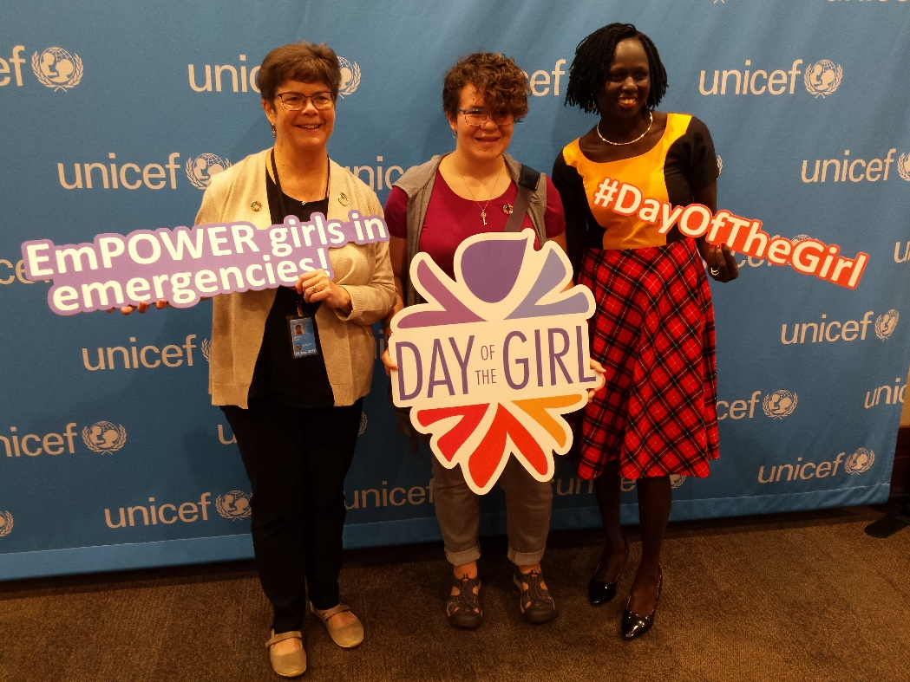
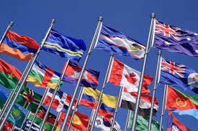
Society of the Sacred Heart at the UN
To Seek Justice with the Heart of an Educator
How does the Society of the Sacred Heart live its educational mission as an NGO with ECOSOC Status?

Slide 17
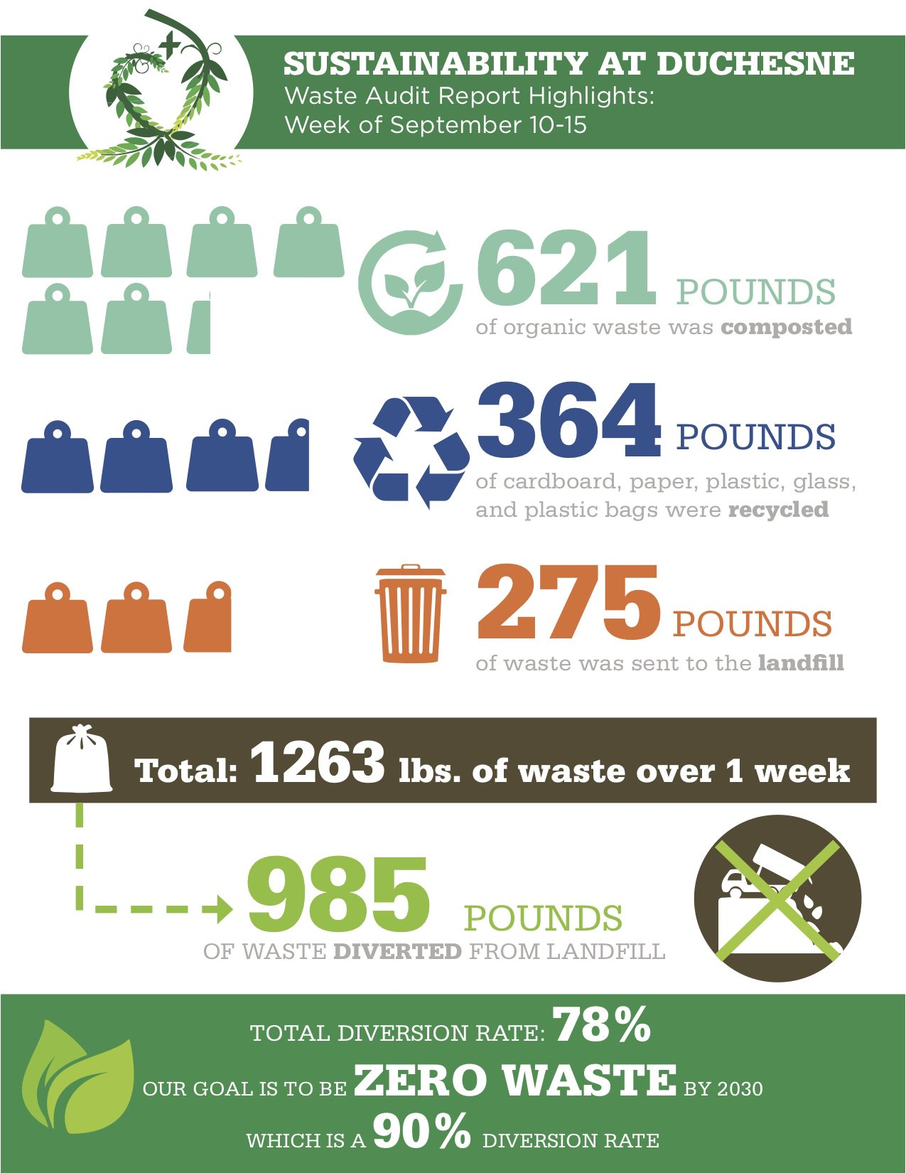
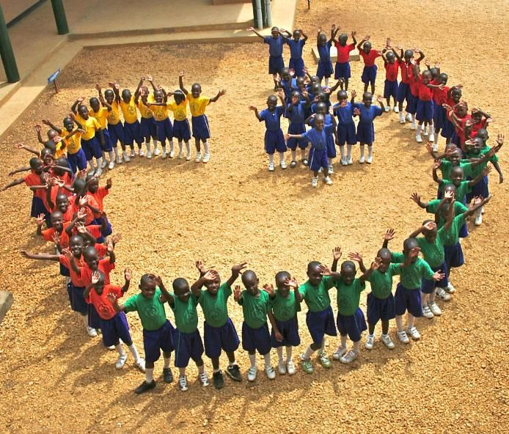
Sustainable Development Goals in practice…
Fatima Santalo-Ossorio, rscj
Socio-Educational Project
in Almeria, Spain.
Help provide work for migrants.
SDG #8 Decent Work and Economic Growth
Kyamusansala SH Primary School, Uganda
SDG #1 Elimination of Poverty
SDG #4 Quality Education
SDG #5 Gender Equality
Duchesne Academy, US
Aiming for zero waste by 2030
SDG #12 Responsible Consumption
Notes:
Here are some example of how the work of the UN-NGO extends to our work in local communities. Fatima is one of many RSCJ who works with migrants. Two of the SDGs that relate to migration, as found in the International Organization for Migration (IOM) pamphlet:
SDG 3 (Good Health and Wellbeing): For example, assisting vulnerable migrants and affected communities living in and around internally displaced people (IDP) settlements in health facilities.
SDG 4 (Quality Education) For example, conducting resettlement activities including teaching, cultural orientation and travel arrangements.
SDG 5 (Gender Equality): For example, empowering girls to address school drop -out, early marriage, and job segregation.

Slide 18
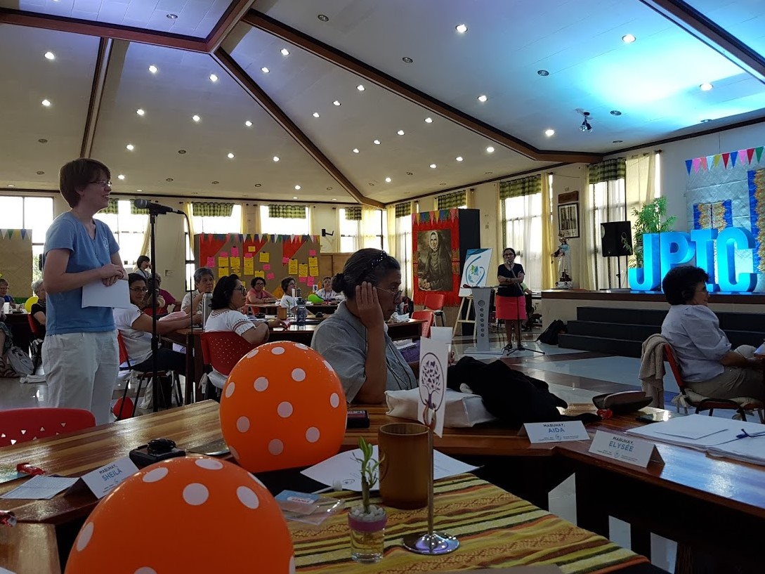
The Process continued…
Discussion in regions re action together
Group delegated to write new articulation of JPIC
Plenaries re themes and new articulation
Sharing from Commission Representatives

Slide 19
Paraphrasing Juan Luis Hernández
Share dreams, build Utopias
Organise, share projects
Care for yourself, others and our common home
Practise judgement, contemplating the crucified Christ and the experience of His Resurrection
Centre yourself in your own locality
Be glocal
Be people of Hope

