Slide 1
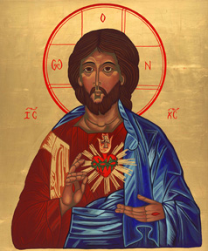
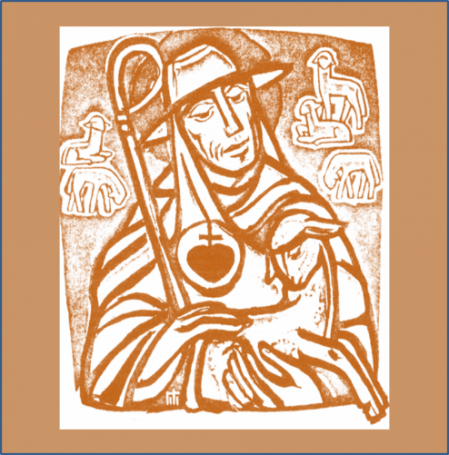
The Charism of the Society: (from the constitutions, 1987)
By our charism, we are consecrated
to GLORIFYING THE HEART OF JESUS:
we answer His call
to discover and reveal His love
letting ourselves be transformed by His Spirit
so as to live united and conformed to Him,
and through our love and service
to radiate the very love of His Heart. (4)
Notes:
You all have copies of this and a couple more of the constitutions to do with education in the 2 languages here.
Following Vatican II the Society undertook lengthy and full revision of their constitutions. The result is a beautiful document. Number 4 is one of the key clauses. Written for the primary interpreters of the mission of the Sacred Heart, I would dare to say that I can see this alive in the schools I visit where there are no RSCJ and sometimes there haven’t been for a while.

Slide 2
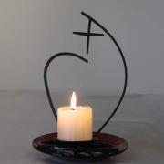
We participate in the mission of the Church
through the service of education
which is our way of continuing the work of Christ.
This service of education and instruction is directed chiefly towards the young and those who bear within them the future of the world.
Caught up as we are in the desires of His Heart,
we want people to grow in dignity, as human beings
and as children of God
Our starting point is the Gospel
with all that it demands from us of love, forgiveness
and justice,
and of solidarity with those who are poor
and rejected by the world. (7)

Slide 3
Saint Madeleine Sophie chose to express this conviction
through the service of education, especially of the young.
Faithful to her inspiration, and, like her, open to new situations,
we make her desire our own:
- that people become ever more aware of truth, of love
and of freedom
- that they discover the significance of their lives,
and devote themselves to others
- that they take part creatively in the common effort to
transform the world
- that they be enabled to encounter the love of Jesus
- that they let their lives be shaped by an active faith. (11)

Slide 4
The Charism of the Society: (from the constitutions, 1987)
Por nuestro carisma estamos consagradas
a glorificar al Corazón de Jesús.
Llamadas a descubrir y manifestar su amor,
respondemos dejándonos transformar por el Espíritu
para vivir en unión y conformidad con el Señor
y expresar a través de nuestro amor y de nuestro servicio
la caridad de su Corazón. (4)
Notes:
You all have copies of this and a couple more of the constitutions to do with education in the 2 languages here.
Following Vatican II the Society undertook lengthy and full revision of their constitutions. The result is a beautiful document. Number 4 is one of the key clauses. Written for the primary interpreters of the mission of the Sacred Heart, I would dare to say that I can see this alive in the schools I visit where there are no RSCJ and sometimes there haven’t been for a while.

Slide 5
Participamos en la misión de la Iglesia
por el servicio de educación
que es nuestro medio de continuar la obra de Cristo.
Este servicio de educación y de enseñanza se dirige ante todo 7 a los jóvenes y a aquellos que llevan en sí un germen de futuro.
Impulsadas por el amor del Corazón de Jesús, buscamos el crecimiento de las personas en su dignidad humana y como hijos e hijas de Dios,
a partir del evangelio y de sus exigencias
de amor, de perdón, de justicia y de solidaridad
con los pobres y marginados. (7)

Slide 6
Santa Magdalena Sofía hizo vida esta convicción
por medio del servicio educador, especialmente de la juventud.
Fieles a su inspiración y abiertas como ella a nuevas situaciones, hacemos nuestro su deseo:
que cada persona se abra a la verdad, al amor y a la libertad
- que descubra el sentido de su vida y se entregue a los demás
- que colabore creativamente en la transformación del mundo
- que viva la experiencia del amor de Jesús
- que se comprometa en una fe activa.
(11)

Slide 7
The Charism of the Society: (from the constitutions, 1987)
Par notre charisme, nous sommes consacrées
à GLORIFIER LE COEUR DE JESUS :
nous répondons à l'appel de découvrir et de manifester son Amour
en nous laissant transformer par l'Esprit
pour vivre en union et conformité au Seigneur
et rayonner par notre amour et notre service
la charité même de son Coeur.
Notes:
You all have copies of this and a couple more of the constitutions to do with education in the 2 languages here.
Following Vatican II the Society undertook lengthy and full revision of their constitutions. The result is a beautiful document. Number 4 is one of the key clauses. Written for the primary interpreters of the mission of the Sacred Heart, I would dare to say that I can see this alive in the schools I visit where there are no RSCJ and sometimes there haven’t been for a while.

Slide 8
Nous participons à la mission de l'Eglise
par le service de l'éducation
qui est notre moyen de poursuivre l'oeuvre du Christ.
Ce service d'éducation et d'instruction s'adresse d'abord aux jeunes et à ceux qui portent en eux l'avenir du monde.
Saisies par l'amour qui est dans son Coeur, nous cherchons à faire grandir la personne dans sa dignité humaine et d'enfant de Dieu,
à partir de l'Evangile et de ses exigences d'amour, de pardon, de justice, de solidarité avec les pauvres et les marginaux. (7)

Slide 9
Sainte Madeleine-Sophie a incarné cette conviction
dans le service de l'éducation, surtout de la jeunesse.
Fidèles à son inspiration et, comme elle, ouvertes aux situations nouvelles,
nous faisons nôtre son désir
que chaque personne s'éveille à la vérité, à l'amour et à la liberté,
qu'elle découvre le sens de sa vie et se donne aux autres,
qu'elle apporte sa part créative dans la transformation du monde,
qu'elle puisse rencontrer l'amour de Jésus,
qu'elle s'engage dans une foi active.
(11)

