Slide 1
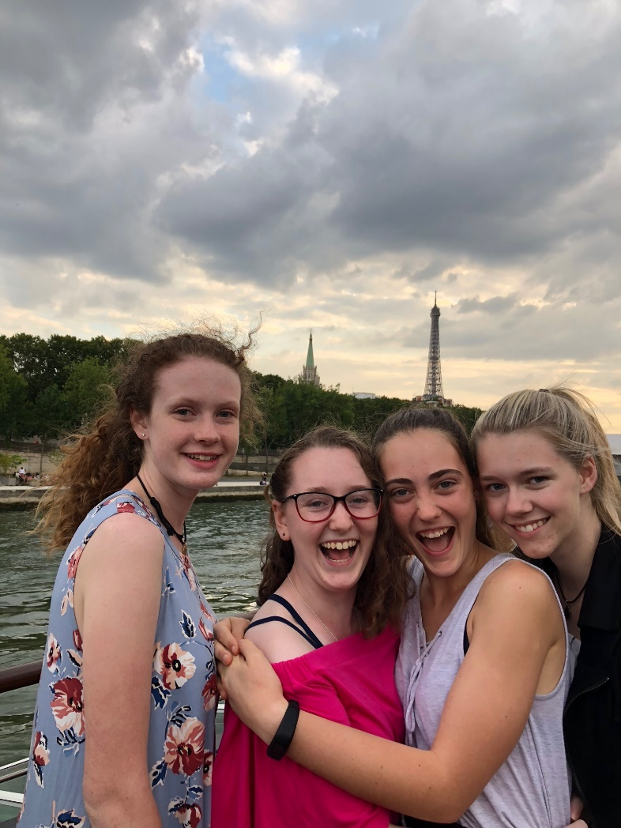
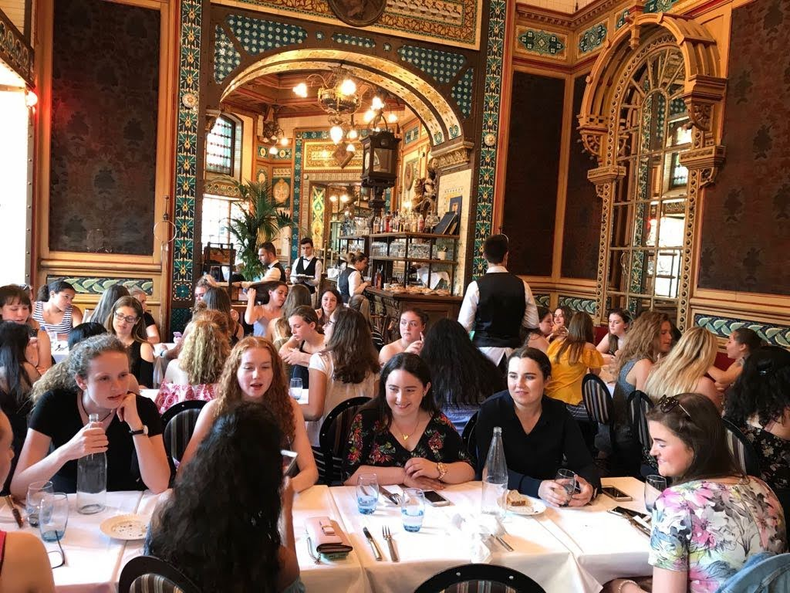
Faces of Heart 2018: Sightseeing in Paris

Slide 2
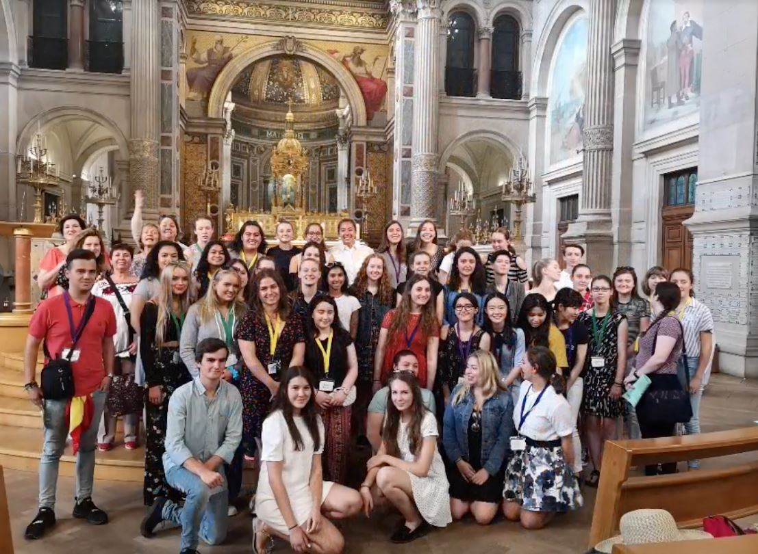
At St Francois Xavier Church in Paris

Slide 3
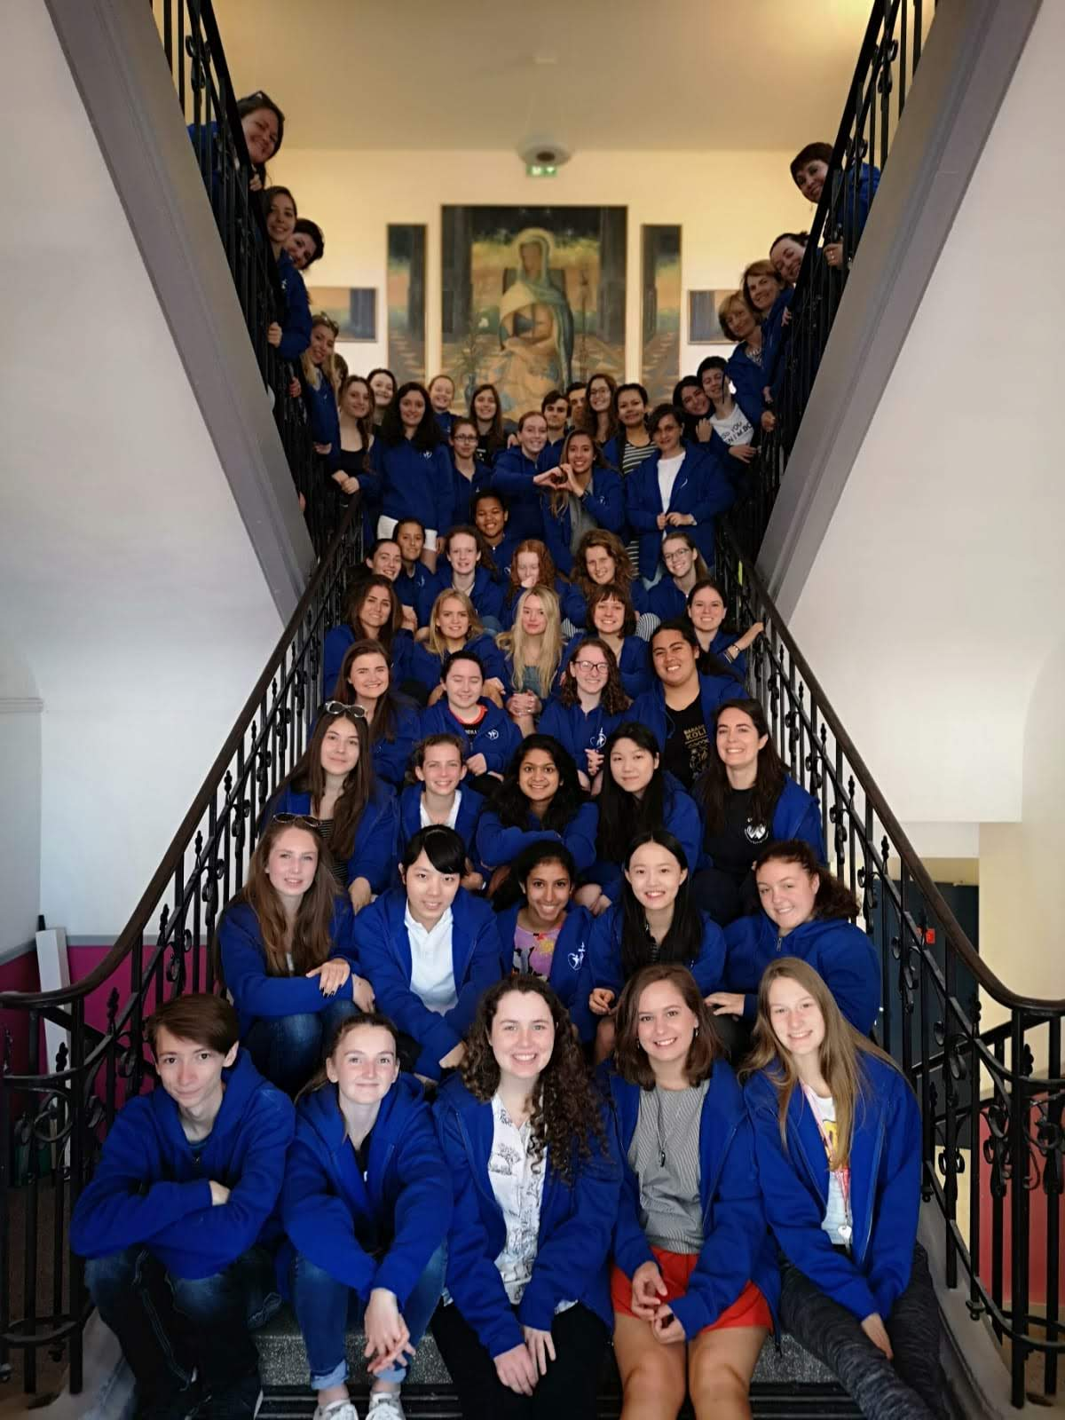
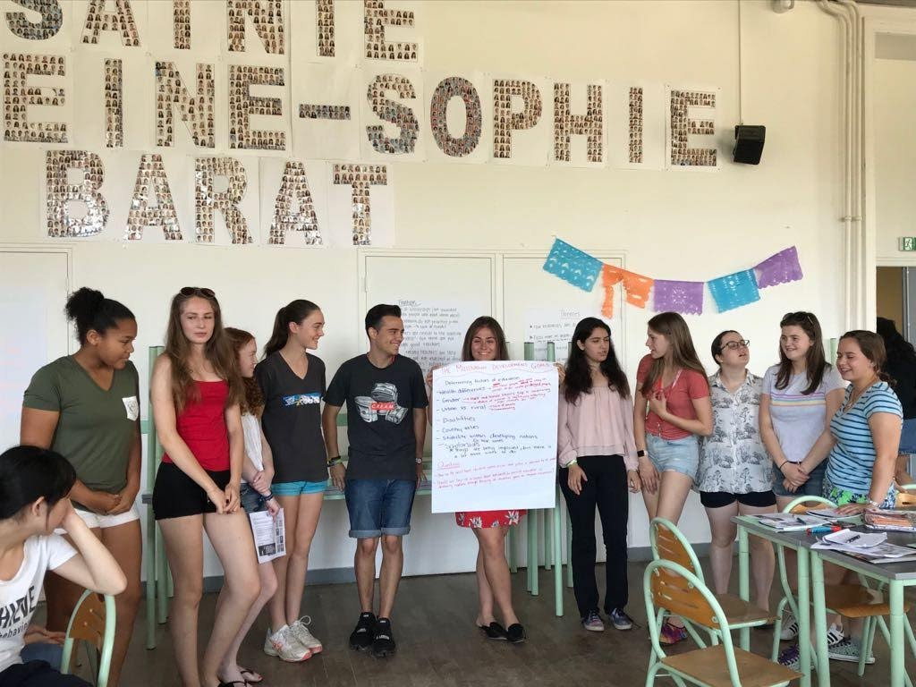
At La Perverie, Nantes: on the staircase and one of our presentations

